Slide 1
Computer Organization & Design —The Hardware/Software Interface
Chapter 4-2 Processor Design
Pipelining CPU

Slide 2
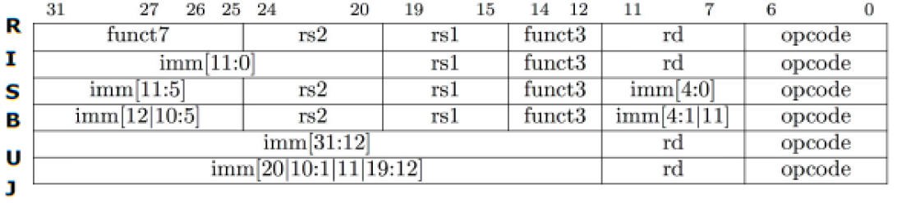
Instruction format
R-type: ALU rd, rs1, rs2
I-type: ALU rd, rs1, imm，LW rd, imm(rs1)
S-type: SW rs2, imm(rs1)
B-type: if rs1 op rs2 then pc←pc + imm else pc←pc+4
U-type: LUI rd, imm
J-type: JAL lable

Slide 3
Function of Instructions
Instruction Fetch
IR ←InstMem[PC], PC4←PC+4
Instruction decode & Read Oprand
A← Reg[Rs], B←Reg[Rt], imm ←immgenerator, decode,
Execution
ALU： ALUout←A op B; ALUout ← A op imm;
LW/SW： ALUout ← A + imm; （address calculation）
Branch： cond ← A compare B, PC ←PC + imm <<1 if taken;
Access Memory
LW： LMDR ←DataMem[ALUout] ; SW: B →DataMem[ALUout]
Write Back
ALU： Rd ← ALUout； LW：Rd ← LMDR
Used Function Units
Instrction Mem, Adder
Register File(read), immgenerator
controller
ALU, comparator
Data Mem
Register File(write)

Slide 4
Review
Instr | Instr fetch | Register read | ALU op | Memory access | Register write | Total time
ld | 200ps | 100 ps | 200ps | 200ps | 100 ps | 800ps
sd | 200ps | 100 ps | 200ps | 200ps |  | 700ps
R-format | 200ps | 100 ps | 200ps |  | 100 ps | 600ps
beq | 200ps | 100 ps | 200ps |  |  | 500ps
I-Memory and D-Memory are used in different stage.
PC+4, PC+4+imm<<2, ALU operation are calculated in different stages.
So memory and ALU can be shared in different stages.

Slide 5
Multicycle Approach (seldom used now)
We will be reusing functional units
ALU used to ( A op B), compute address, increment PC,
Memory used for instruction and data
We will use a finite state machine（FSM） for control

Slide 6
Review: Finite state machines
Finite state machines:
a set of states
next state function (determined by current state and the input)
output function (determined by current state and possibly input)

Slide 7
Multi-cycle CPU datapath
ALU used for pc+4, pc+imm<<1, A op B，
separate comparator for condition comparing for Branch instruction

Slide 8
Multicycle Approach
Break up the instructions into steps, each step takes a cycle
balance the amount of work to be done
restrict each cycle to use only one major functional unit
At the end of a cycle
store values for use in later cycles
introduce additional internal registers

Slide 9
Multicycle Approach
a Multicycle datapath
shared unit

Slide 10
How to use one memory to implement Inst. fetch and data access?
IorD
WriteMem
ReadMem
WriteIR
ALUout
MUX
Address
Data out
Data
PC
PC
PC
IR
DR
B
WriteDR
Instruction fetch
Can load data from memory
Can store data to Memory

Slide 11
How to implement Adders and ALU ops using one ALU
PC
A
A
A
ALU
ALUout
B
B
4
B
imm generator
<<1
Operation
Can also do A+imm
(ALU-R-I)operation
Mem Address calculation
Can also do
PC + imm< <１
Only ALU operation
Can do PC+4 too

Slide 12
Data path in detail
Imm
generator
<<1

Slide 13
How does it control in Multicycle Approach
Imm
generator
<<1

Slide 14
Graphical Specification of FSM
jump
sw
beq
lw
R-type

Slide 15
The truth table for the datapath control outputs, which depend only on the state inputs.

Slide 16
The logic equations for the control unit shown in a shorthand form

Slide 17
Implemented using a block of combinational logic and a register to hold the the current state
Combinational
Control logic
Datapath control output
Outputs
Inputs
Next state
State register

Slide 18
Contents
Introduction & Logic Design Conventions
Building a datapath
A Simple Implementation Scheme
Pipelining
Why pipelining
Pipelined datapath and control
Pipeline Hazards
Exceptions

Slide 19
4.6 An Overview of Pipelining
What is Pipelining:
“A technique designed into some computers to increase speed by starting the execution of one instruction before completing the previous one.”
----Modern English-Chinese Dictionary
implementation technique whereby different instructions are overlapped in execution at the same time.
implementation technique to make fast CPUs

Slide 20
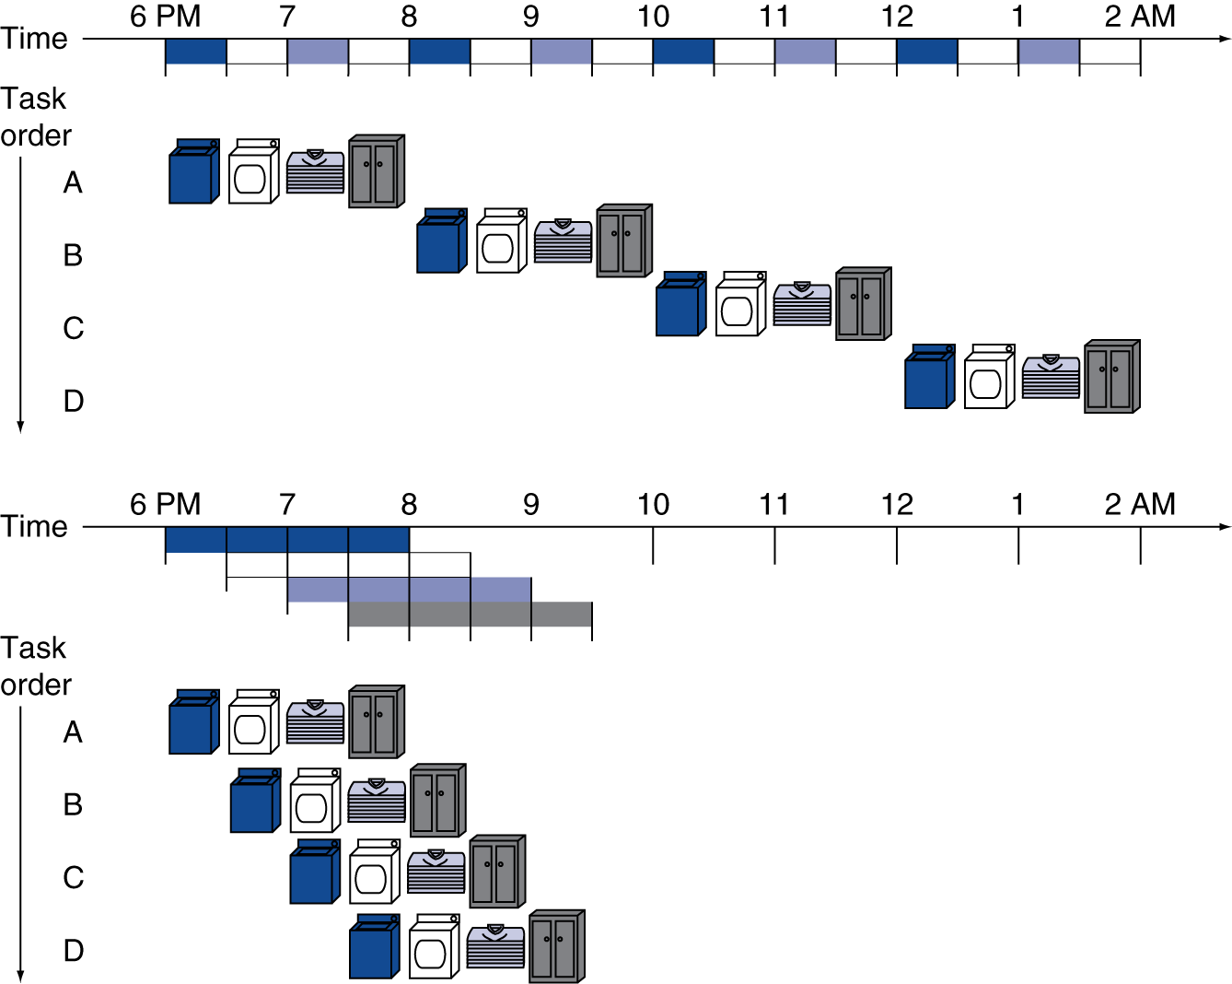
Pipeline Analogy
pipelined laundry: overlapping execution
Parallelism improves performance
Four loads:
Speedup = 8/3.5 = 2.3
Non-stop:
Speedup = 2n/(0.5n + 1.5) ≈ 4 = number of stages
Notes:
每个30分钟

Slide 21
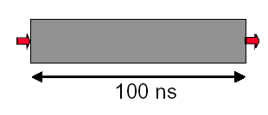
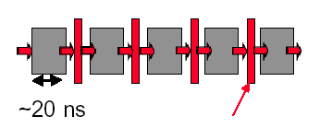
4.6.1 Why pipelining : overlapped, more faster
Only deal one task each time.
This task takes “ such a long time”
Can “launch” a new computation every 100ns in this structure
Can finish 10⁷ computations per second
Latches, called pipeline registers’ break up computation into 5 stages
Deal 5 tasks at the same time.
Can launch a new computation every 20ns in pipelined structure
Can finish 5×10⁷ computations per second

Slide 22
Why pipelining : conclusion
The key implementation technique used to Make fast CPU: decrease CPUtime.
Improving of Throughput ( rather than individual execution time)
Improving of efficiency for resources (functional unit)

Slide 23
What is a pipeline ?
A pipeline is like an auto assemble line
A pipeline has many stages
Each stage carries out a different part of instruction or operation
The stages, which cooperates at a synchronized clock, are connected to form a pipe
An instruction or operation enters through one end and progresses through the stages and exit through the other end
Pipelining is an implementation technique that exploits parallelism among the instructions in a sequential instruction stream

Slide 24
Pipeline Characteristics -- latency vs. Throughput
Latency
Each instruction takes a certain time to complete. This is the latency for that operation.
It's the amount of time between when the instruction is issued and when it completes.
Throughput
Number of items (cars, instructions) exiting the pipeline per unit time.
The throughput of the assembly line is the number of products completed per hour.
The throughput of a CPU pipeline is the number of instructions completed per second.

Slide 25
Pipeline Characteristics – clock cycle vs. Machine cycle
Clock cycle
Everything in a CPU moves in lockstep, synchronized by the clock ( The Heartbeat of CPU )
Machine cycle (Processor cycle, Stage time)
time required to complete a single pipeline stage.
The pipeline designer’s goal is to balance the length of each pipeline stage.
In many instances, machine cycle = max ( times for all stages).
A machine cycle is usually one, sometimes two, clock cycles long, but rarely more.

Slide 26
RISC-V Pipeline
Five stages, one step per stage
IF: Instruction fetch from memory
ID: Instruction decode & register read
EX: Execute operation or calculate address
MEM: Access data memory operand
WB: Write result back to register

Slide 27
Pipeline Performance
Assume time for stages is
100ps for register read or write
200ps for other stages
Compare pipelined datapath with single-cycle datapath
Instr | Instr fetch | Register read | ALU op | Memory access | Register write | Total time
ld | 200ps | 100 ps | 200ps | 200ps | 100 ps | 800ps
sd | 200ps | 100 ps | 200ps | 200ps |  | 700ps
R-format | 200ps | 100 ps | 200ps |  | 100 ps | 600ps
beq | 200ps | 100 ps | 200ps |  |  | 500ps

Slide 28
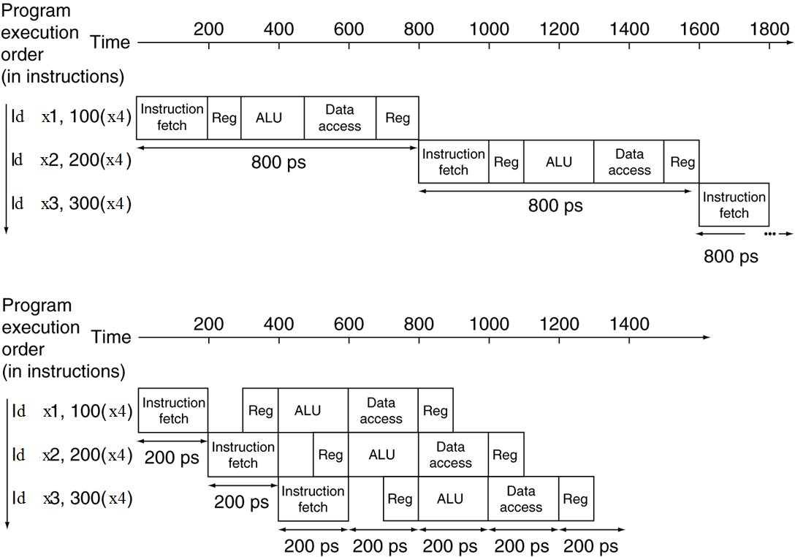
Pipeline Performance
Single-cycle (T_{c}= 800ps)
Pipelined (T_{c}= 200ps)

Slide 29
Pipeline Speedup
If all stages are balanced
i.e., all take the same time
Time between instructions _{pipelined} =
Ideal speedup is Number of pipe stages
If not balanced, speedup is less
Speedup due to increased throughput
Latency (time for each instruction) does not decrease
Time between instructions _{nonpipelined}
Number of stages

Slide 30
4.6.2 Pipelining and ISA Design
RISC-V ISA designed for pipelining
All instructions are 32-bits
Easier to fetch and decode in one cycle
c.f. x86: 1- to 17-byte instructions
Few and regular instruction formats
Can decode and read registers in one step
Load/store addressing
Can calculate address in 3rd stage, access memory in 4th stage
Notes:
The abbreviation cf. (short for the Latin: confer/conferatur, both meaning "compare")

Slide 31
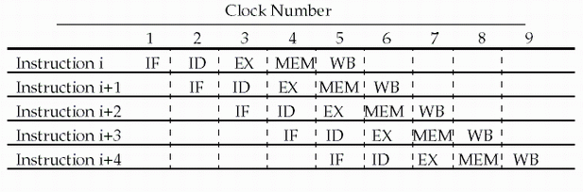
Pipelining RISC-V instruction set
Since there are five separate stages, we can have a pipeline in which one instruction is in each stage.
CPI is decreased to 1, since one instruction will be issued (or finished) each cycle.
During any cycle, one instruction is present in each stage.
Ideally, performance is increased five fold !

Slide 32
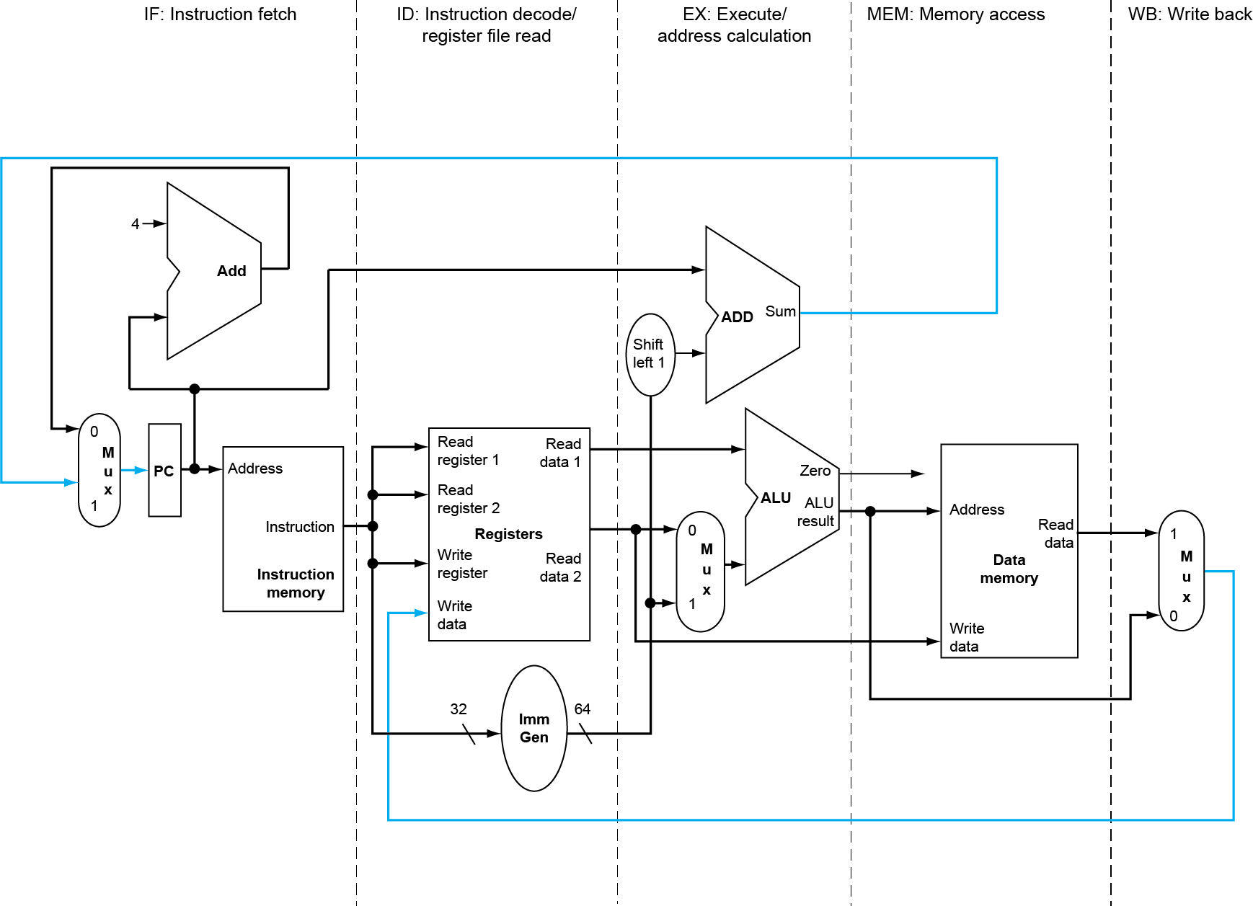
Pipelined Datapath and Control
RISC-V Pipelined Datapath
MEM
Right-to-left flow leads to hazards
WB

Slide 33
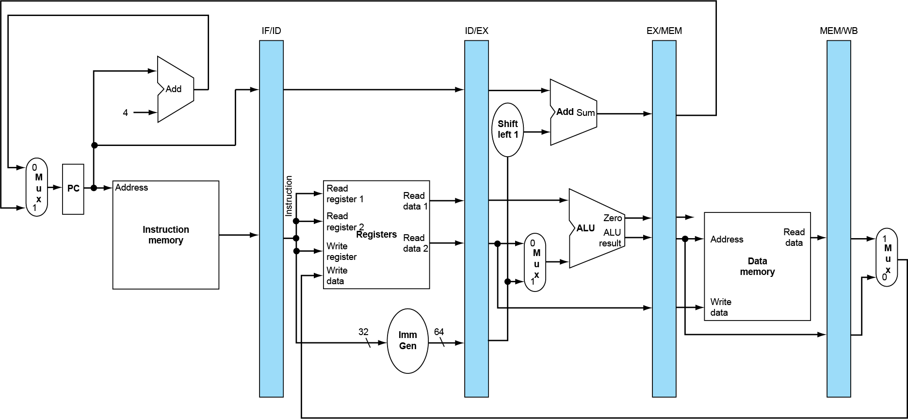
Pipeline registers
Need registers (or latch) between stages
To hold information produced in previous cycle

Slide 34
What should be latched ?
Is register PC a latch ？
What are stored in latch IF/ID ?
IR, anything else ?
What are stored in latch ID/EX ?
A, B, imm, anything else ?
What are stored in latch EX/MEM ?
ALUoutput, anything else ?
What are stored in latch MEM/WB ?
LMDR, ALUoutput, Wreg, anythingelse ?

Slide 35
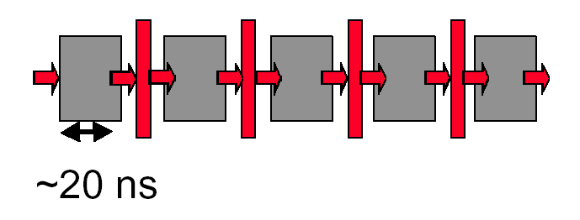
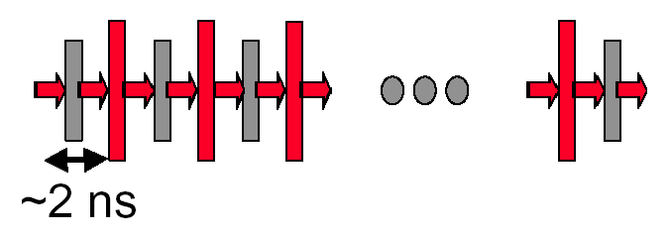
Why not just make a 50-stage pipeline?
Some computations just won’t divide into any finer (shorter in time) logical implementation.
5 stages OK
50 stages NO. Sorry!

Slide 36
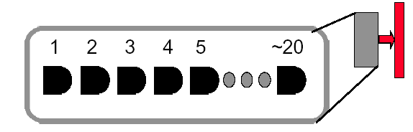
Why not just make a 50-stage pipeline?
Those latches are NOT free, they take up area, and there is a real delay to go THRU the latch itself.
Machine cycle > latch latency + clock skew
In modern, deep pipeline (10-20 stages), this is a real effect
Typically see logic “depths” in one pipe stage of 10-20 “gates”.
At these speeds, and with this few levels of logic, latch delay is important

Slide 37
performance issues in pipelining
Latency: The execution time of each instruction in pipelining does not decrease, instead, always longer than that of unpipelined machine.
Imbalance among stages reduces performance
Overhead rise from register delay and clock skew also contribute to the lower limit of machine cycle.
Pipeline hazards are the major hurdle of pipeline, which prevent the machine from reaching the ideal performance.
Time to “fill” pipeline and time to “drain” it reduces speedup

Slide 38
Pipeline Operation
Cycle-by-cycle flow of instructions through the pipelined datapath
“Single-clock-cycle” pipeline diagram
Shows pipeline usage in a single cycle
Highlight resources used
c.f. “multi-clock-cycle” diagram
Graph of operation over time
We’ll look at “single-clock-cycle” diagrams for load & store

Slide 39
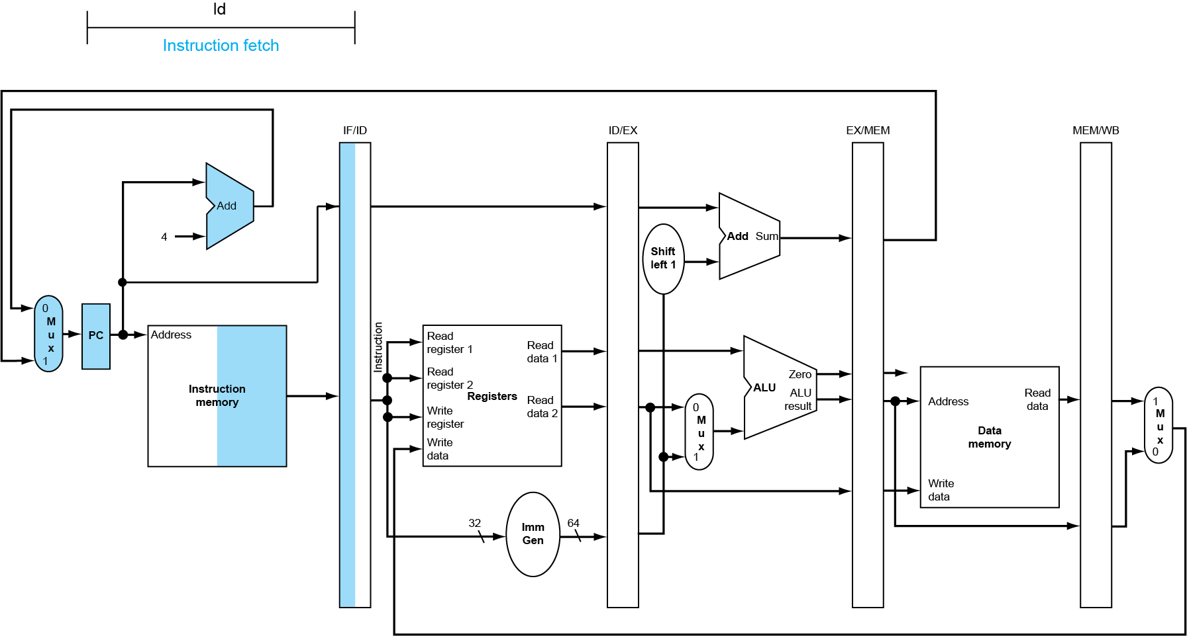
IF for Load, Store, …

Slide 40
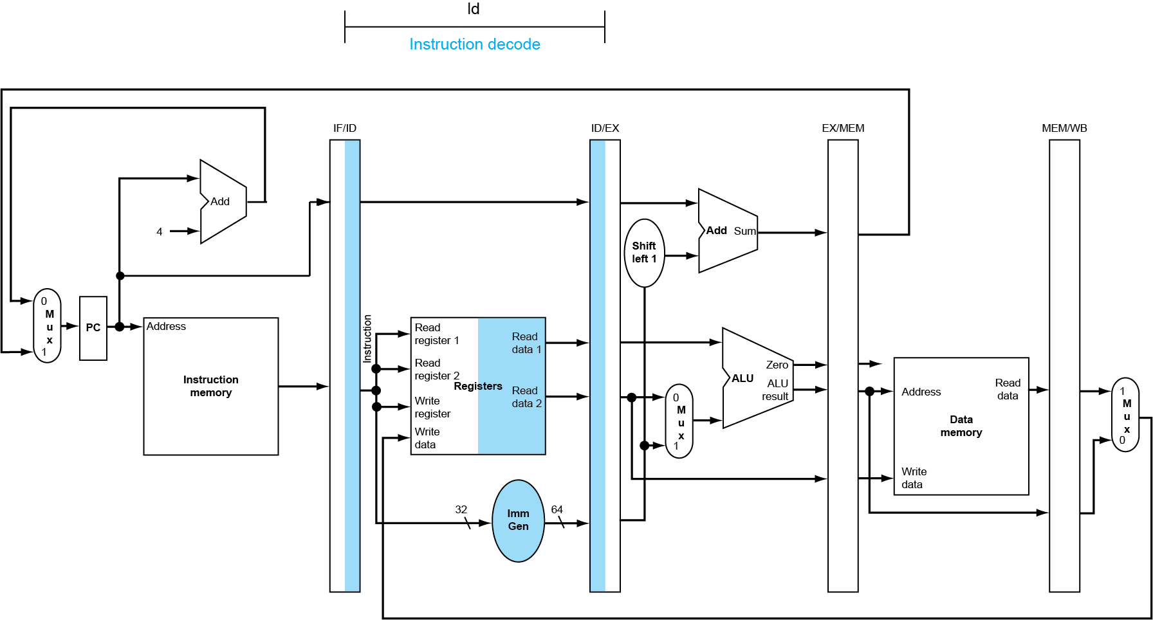
ID for Load, Store, …

Slide 41
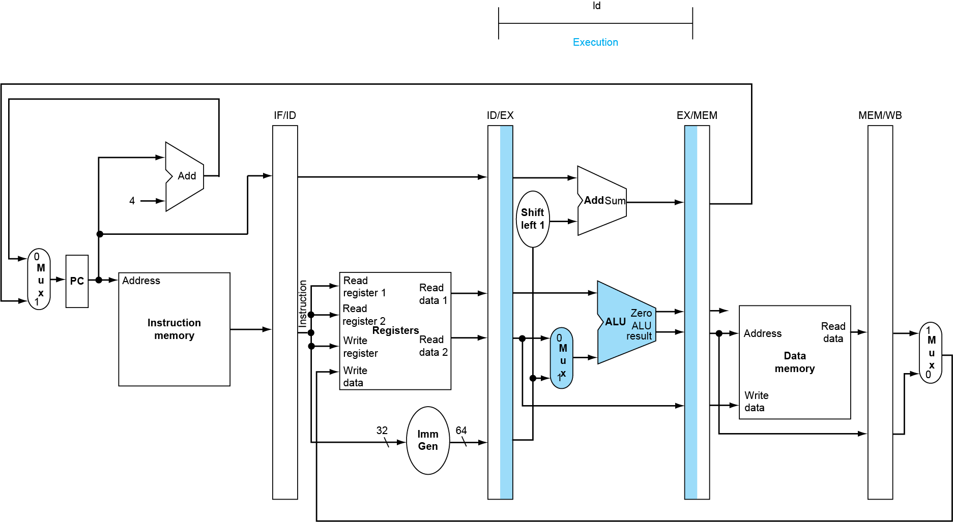
EX for Load

Slide 42
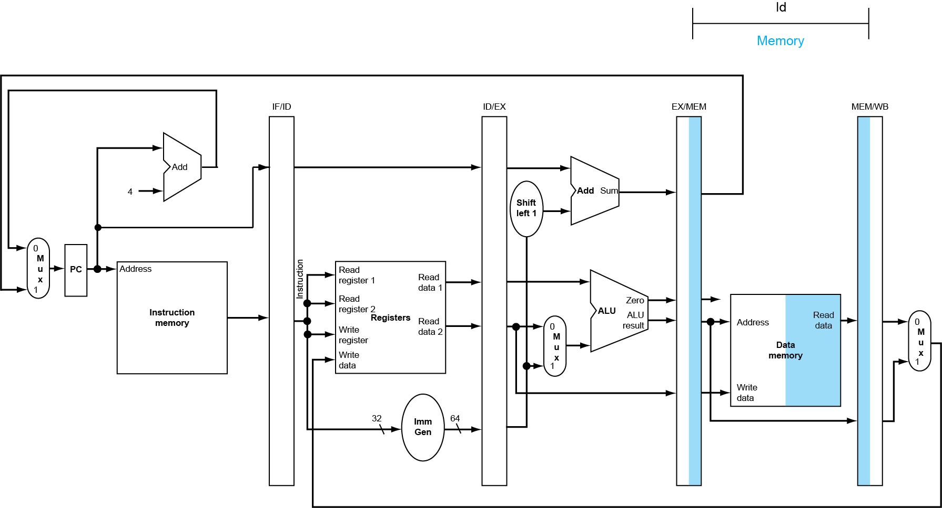
MEM for Load

Slide 43
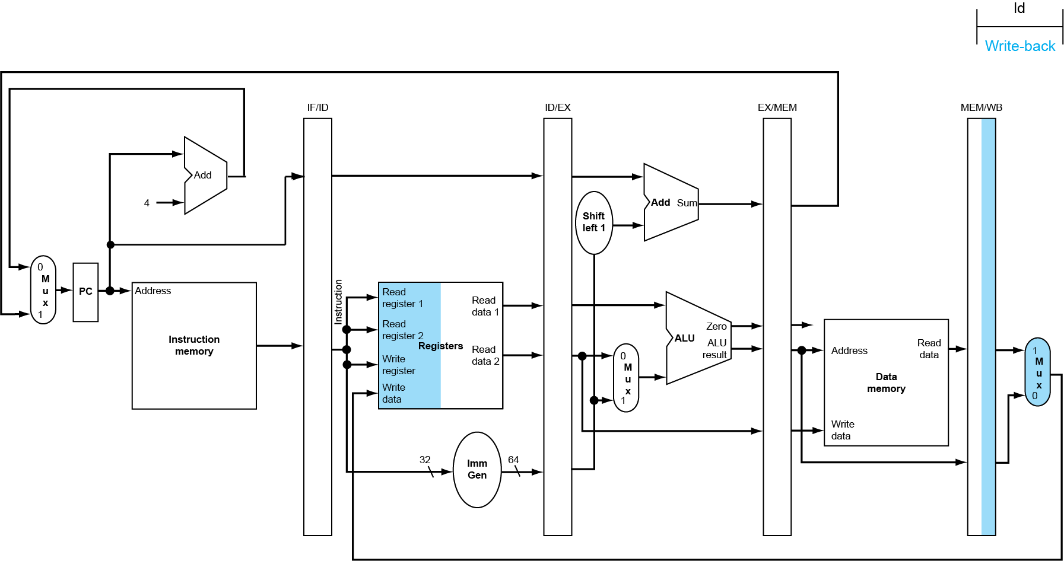
WB for Load
Wrong register number

Slide 44
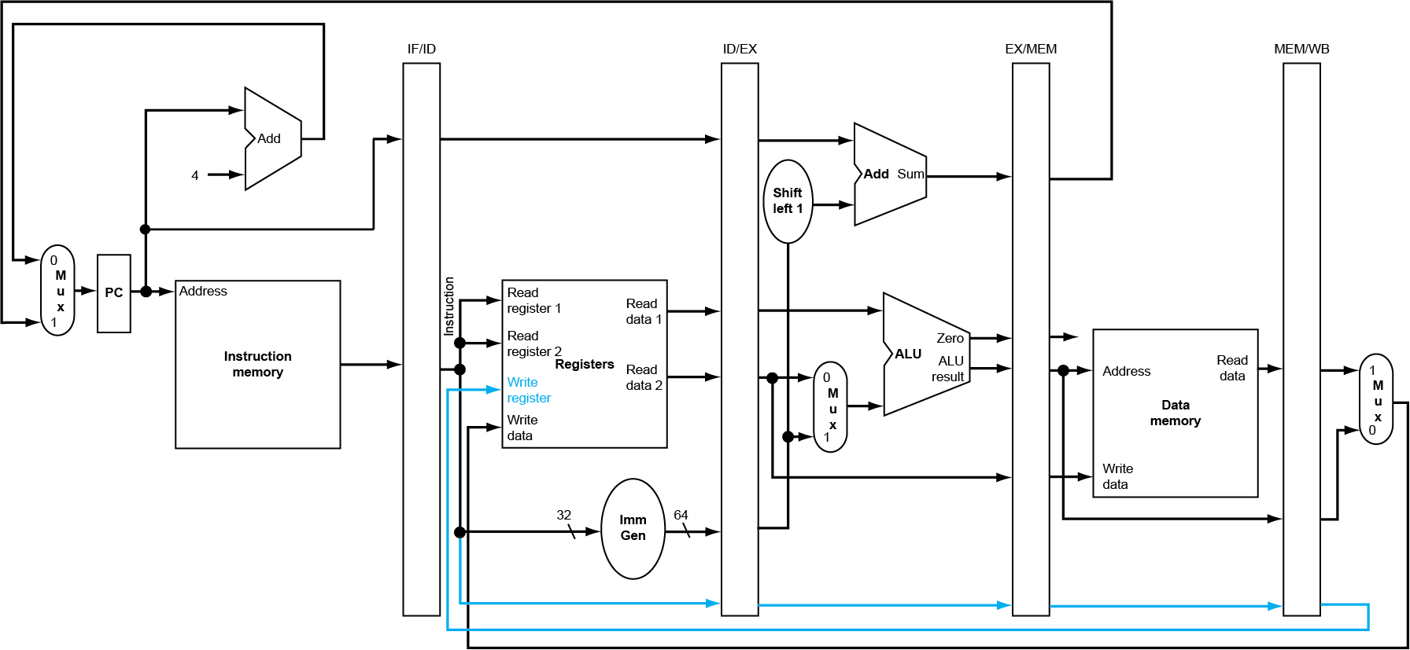
Corrected Datapath for rd

Slide 45
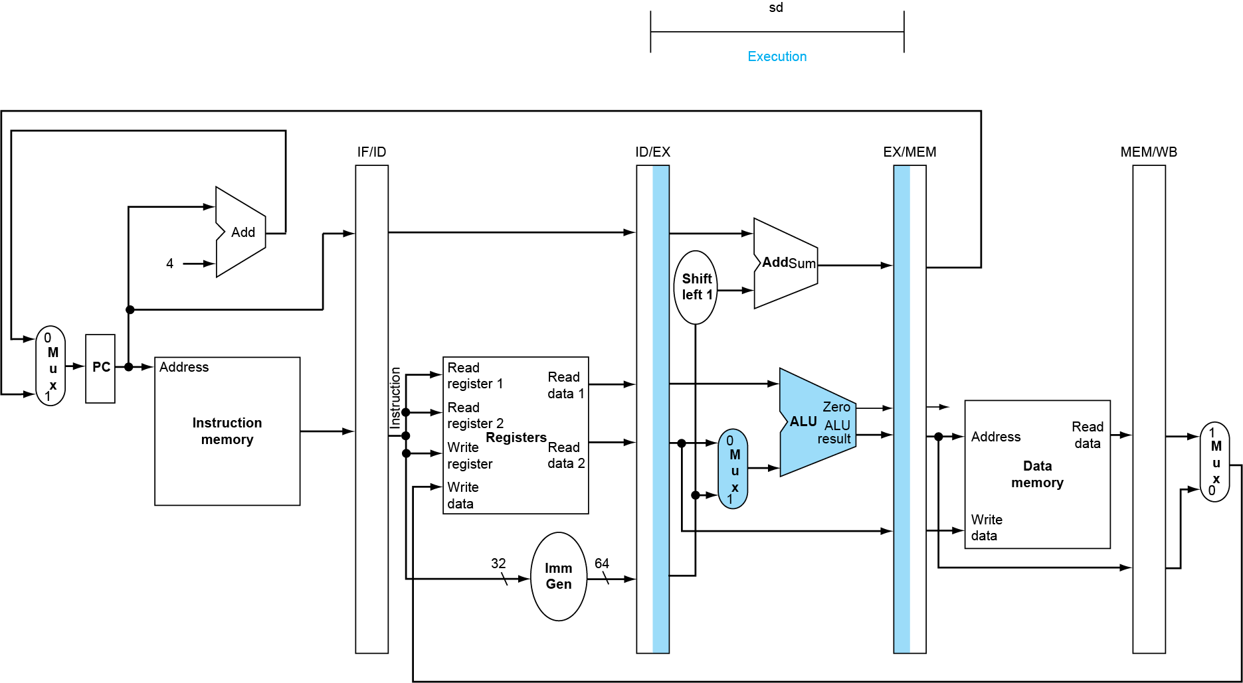
EX for Store

Slide 46
MEM for Store

Slide 47
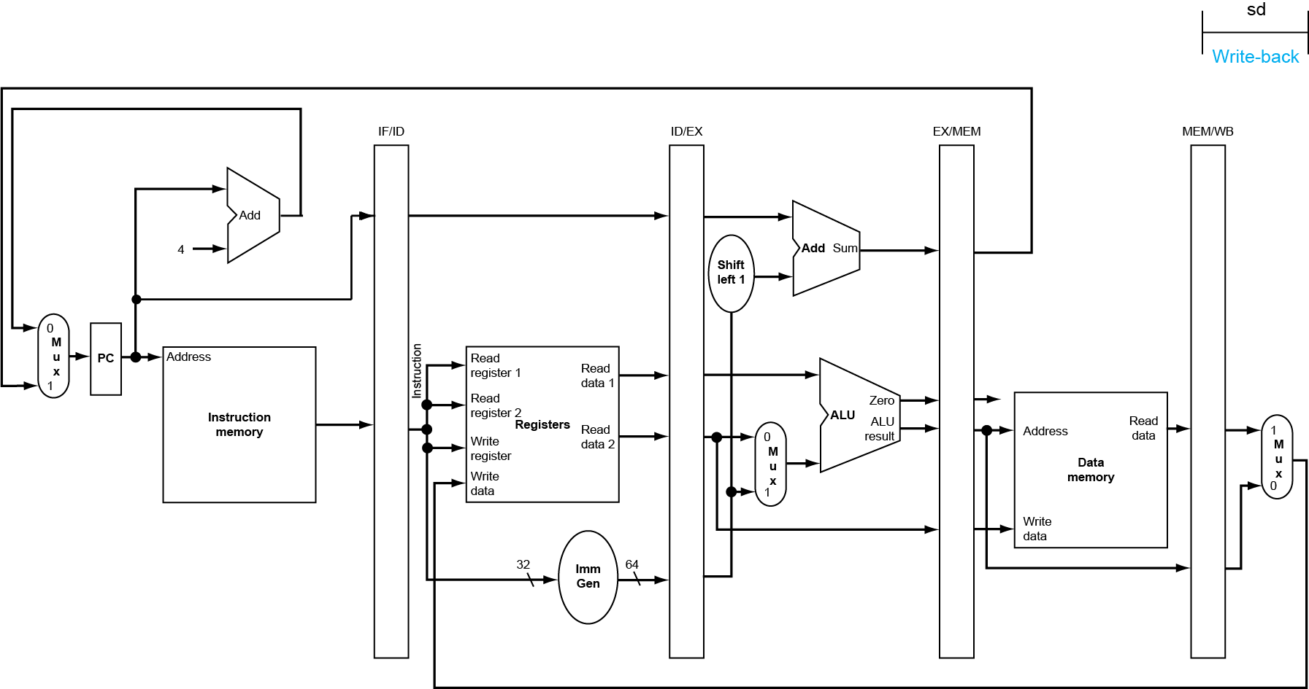
WB for Store

Slide 48
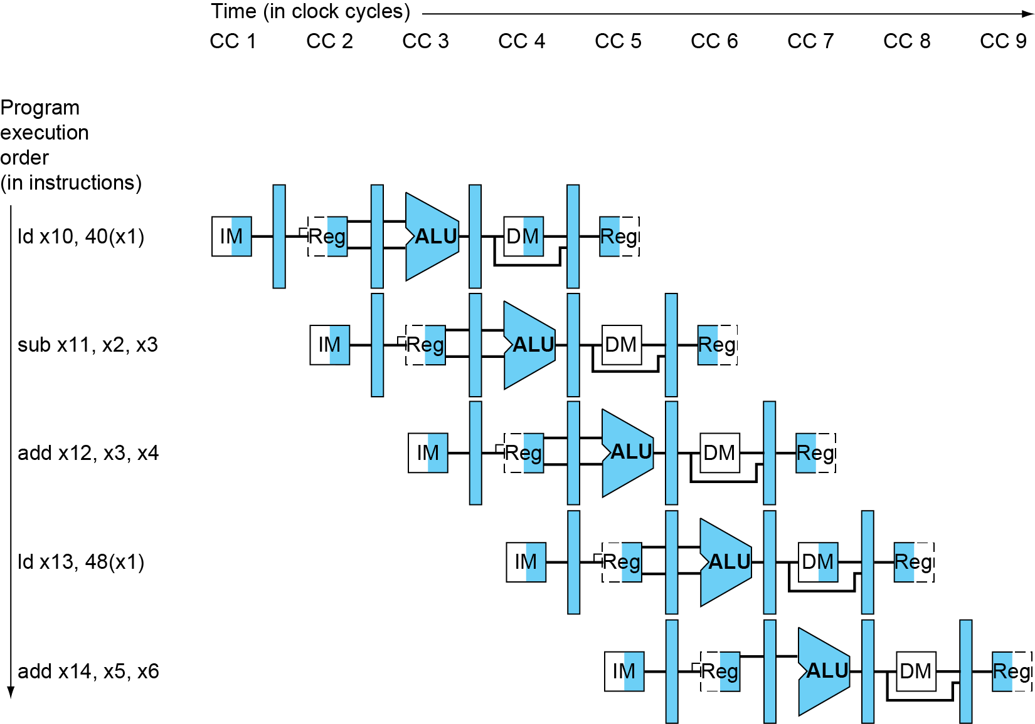
Multi-Cycle Pipeline Diagram
Form showing resource usage

Slide 49
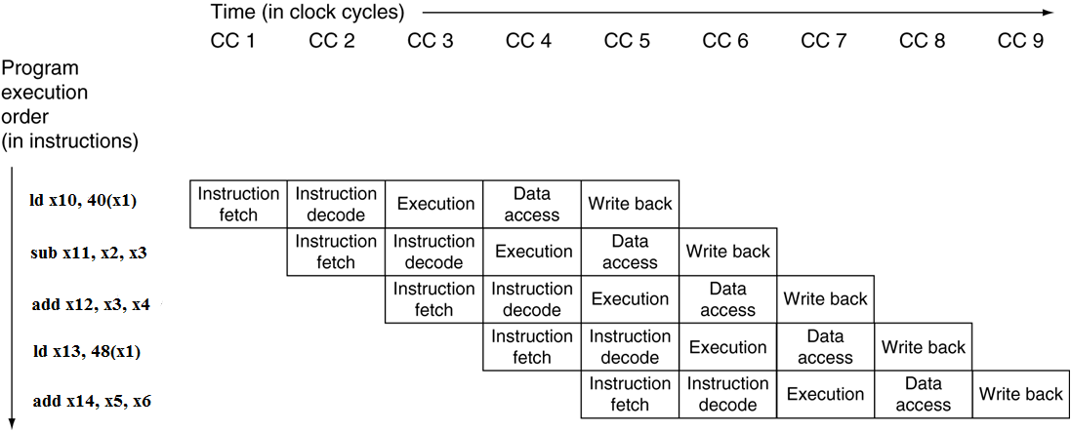
Multi-Cycle Pipeline Diagram
Traditional form

Slide 50
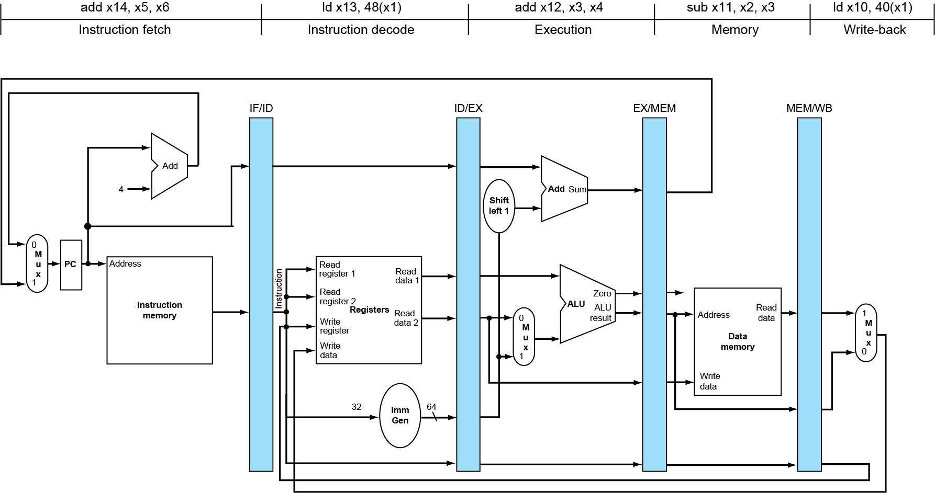
Single-Cycle Pipeline Diagram
State of pipeline in a given cycle

Slide 51
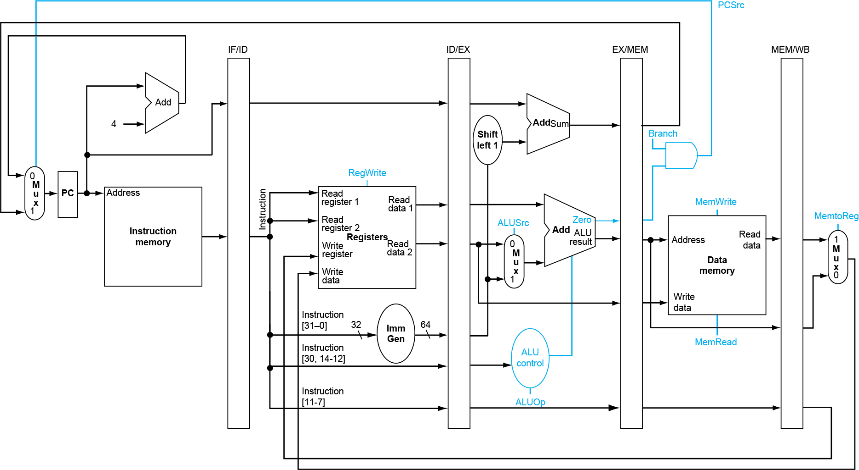
Pipelined Control (Simplified)

Slide 52
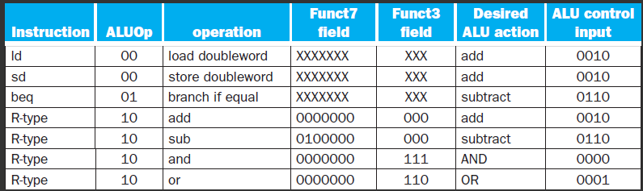
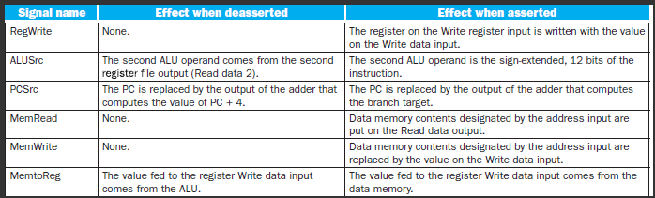
Review of Control Signals

Slide 53
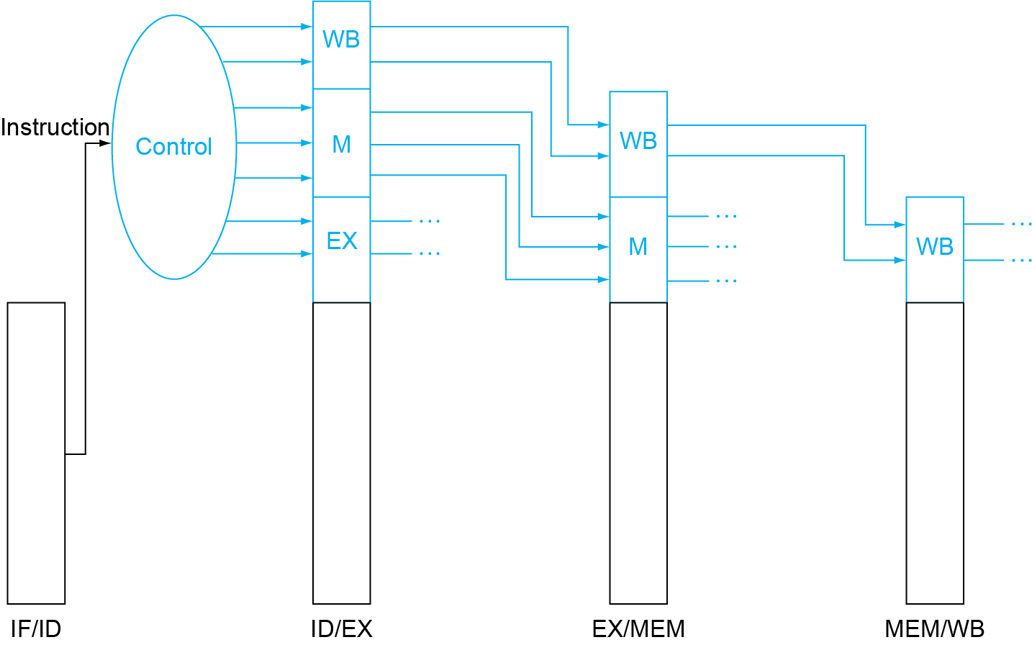
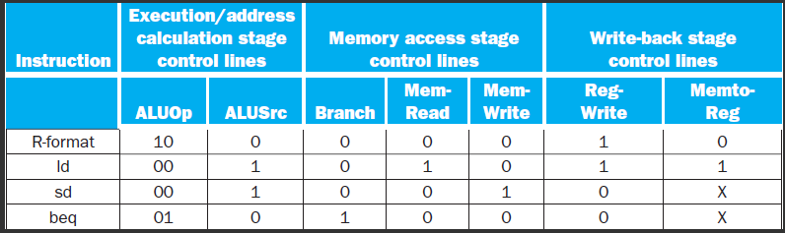
Pipelined Control
Control signals derived from instruction
As in single-cycle implementation

Slide 54
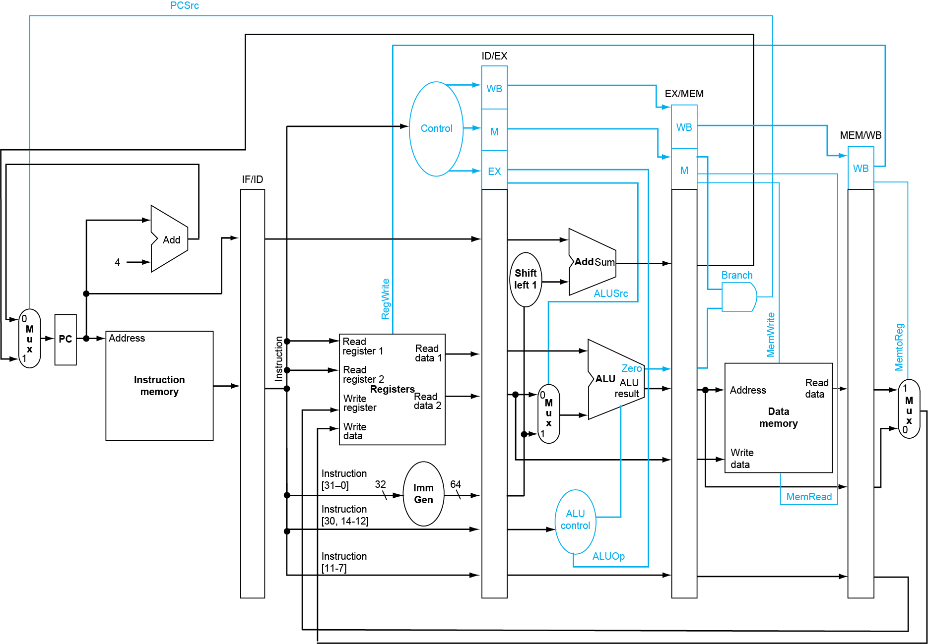
Pipelined Control

Slide 55
Important Notes:
What should be buffered in every stage register ?
Data need to be used in the next stages.
Control signals need to be used in the next stages
Debug info when used in duration of design
The memory bandwidth changes !
1 instruction read + 1 data access / 5 cycle (multi-cycle implementation)
1 instruction read + 1 data access / cycle

Slide 56
Problems that pipeline introduces
Right-to-left flow leads to hazards

Slide 57
Hazards
Hazards: Situations that prevent starting the next instruction in the next cycle
Structure hazards
A required resource is busy
Data hazard
Need to wait for previous instruction to complete its data read/write
Control hazard
Deciding on control action depends on previous instruction
Notes:
Hazard 冒险，竞争

Slide 58
Structure Hazards
Conflict for use of a resource
In RISC-V pipeline with a single memory
Load/store requires data access
Instruction fetch would have to stall for that cycle
Would cause a pipeline “bubble”
Hence, pipelined datapaths require separate instruction/data memories
Or separate instruction/data caches
Notes:
Instruction mem和data mem是同一个

Slide 59
A Single Memory Would Be a Structural Hazard
Time (clock cycles)
Reading data from memory or writeing data to memory
ld
Mem
Reg
ALU
Mem
Reg
I
n
s
t
r.
O
r
d
e
r
Inst 1
Mem
Reg
ALU
Mem
Reg
Inst 2
Mem
Reg
ALU
Mem
Reg
Inst 3
Mem
Reg
ALU
Mem
Reg
Inst 4
Reading instruction from memory
Mem
Reg
ALU
Mem
Reg
Fix with separate instr and data memories (I$ and D$)
Notes:
冯诺伊曼体系结构： 指令和数据共存于同一个内存

Slide 60
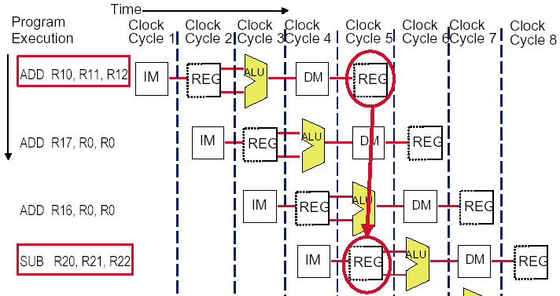
The conflict about the registers !
An instruction depends on completion of data access by a previous instruction ( Data hazard )
R10

Slide 61
How About Register File Access?
Time (clock cycles)
Fix register file access hazard by doing reads in the second half of the cycle and writes in the first half
add x1,
IM
Reg
ALU
DM
Reg
I
n
s
t
r.
O
r
d
e
r
Inst 1
IM
Reg
ALU
DM
Reg
Inst 2
IM
Reg
ALU
DM
Reg
add x2,x1,
IM
Reg
ALU
DM
Reg
clock edge that controls loading of pipeline state registers
clock edge that controls register writing
Notes:
Define register reads to occur in the second half of the cycle and register writes in the first half

Slide 62
Conflict occurs when PC update
Must increment and store the PC every clock.
What happens when meet a branch ?
Branches change the value of the PC -- but the condition is not evaluated until ID !
If the branch is taken, the instructions fetched behind the branch are invalid !
This is clearly a serious problem ( Control hazard ) that needs to be addressed. We will deal it later.

Slide 63
Hazards can always be resolved by Stall
The simplest way to "fix" hazards is to stall the pipeline.
Stall means suspending the pipeline for some instructions by one or more clock cycles.
The stall delays all instructions issued after the instruction that was stalled, while other instructions in the pipeline go on proceeding.
A pipeline stall is also called a pipeline bubble or simply bubble.
No new instructions are fetched during a stall .

Slide 64
How to stall ? -- interlock
Stall = control hazard || structural hazard || data hazard
Control hazard:
Instruction in EX or MEM is a Branch or JMP
Data hazard:
rd of Instruction in EX == rs1 or rs2 of instruction in ID
rd of Instruction in MEM == rs1 or rs2 of instruction in ID

Slide 65
How do we stall ? Insert nop by compiler
Bubble
Bubble
Bubble
Bubble
Bubble
Bubble
Bubble
Bubble
Bubble

Slide 66
Insert stall by compiler
Data hazard
ADD Rx, Ry, Rz
NOP
NOP
AND Rl, Rx, Rw
Control hazard
Beq/Bne Rx, Ry, Label
NOP
…
Pipelining Performance is ate up by inserting NOP by compiler

Slide 67
How do we stall ? Add hardware Interlock!
Add extra hardware to detect stall situations
Watches the instruction field bits
Looks for “read versus write” conflicts in particular pipe stages
Basically, a bunch of careful “case logic”
Add extra hardware to push bubbles throught pipe
Actually, relatively easy
Can just let the instruction you want to stall GO FORWARD through the pipe…
…but, TURN OFF the bits that allow any results to get written into the machine state
So, the instruction “executes” (it does the work), but doesn’t “save”

Slide 68
How to Stall ? Add a stall control logic !
PC IF/ID ID/EX EX/MEM MEM/WB
D.Inst
E.Inst
M.Inst
F.Inst
Bubble
Bubble
Branch
Branch
Wreg
Wreg
rd
rd
Stall control logic
rs1
rs2
To produce a stall signal. If stall ==1 then
Use stall to disable writing PC write and IF/ID latch.
Push a bubble into next stage.
Bubble = 1 and disable control signal Wreg and Wmem.
Puch a nop forward into ID/EX
stall

Slide 69
Control signals
 | Output Signal | Meaning When 1 | Meaning When 0
1 | Cu_branch | Branch Instr. | Non-Branch Instr.
2 | Cu_wmem | Write Mem. | Not Write Mem.
3 | Cu_Mem2Reg | From Mem. To Reg | From ALUOut To Reg
4 | Cu_sext | Sign-extend the imm. | No sign extended the imm.
5 | Cu_aluc | ALU Operation
6 | Cu_aluimm | Imm. | Register data2
7 | Cu_wreg | Write Reg. | Not Write Reg.

Slide 70
Something about control signals
How to know the instruction in EXE/MEM is a Branch?
EXE.branch ==1 or Mem.branch == 1
How to know the instruction in EXE/MEM is a ALU or LW instruction ( has a destination reg.) ?
EXE.Wreg ==1 or Mem.Wreg == 1
How to know the instruction in EXE/MEM is a LW ?
EXE.Wreg==1 and Mem2Reg == 1
Which instruction has no rd?
Sw, Branch
Which instruction has no rs ?
JAL, LUI
Which instruction has rs2 as source register?
ALU r-r, Branch, SW

Slide 71
How to stall ?
Are the stalls the same for
Data hazard / control hazard ?
If stall == 0 //stop the latter ones
then PC ← new PC; IF/ID.IR ← IF.IR
IF/ID.NPC ← PC + 4
If stall == 1 // push bubble forward
then ID/EX.nop ←1 else ID/EX.nop ←0
When initial
ID/EX.nop ←0, EX/MEM.nop ← 0, Mem.WB.nop ←0

Slide 72
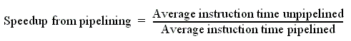
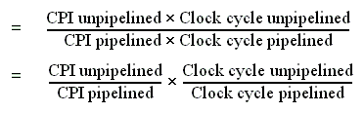
Performance of pipeline with stalls
Pipeline stalls decrease performance from the ideal
Recall the speedup formula:

Slide 73
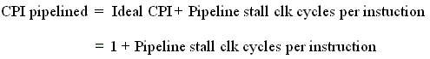
Assumptions for calculation
The ideal CPI on a pipelined processor is almost always 1. (may less than or greater than )
So
Ignore the overhead of pipelining clock cycle.
Pipe stages are ideal balanced.

Slide 74
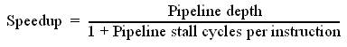
Case of single-cycle implementation
CPI unpipelined = 1
Clock cycle unpipelined
pipeline depth
Clock cycle pipelined =

Slide 75
Pipeline Summary
The BIG Picture
Pipelining improves performance by increasing instruction throughput
Executes multiple instructions in parallel
Each instruction has the same latency
Subject to hazards
Structure, data, control
Stalls reduce performance
but are required to get correct results
Compiler can arrange code to avoid hazards and stalls
requires knowledge of the pipeline structure
Instruction set design affects complexity of pipeline implementation

Slide 76
Hazards
Situations that prevent starting the next instruction in the next cycle
Structure hazards
A required resource is busy
Data hazard
Need to wait for previous instruction to complete its data read/write
Control hazard
Deciding on control action depends on previous instruction
Notes:
Hazard 冒险，竞争

Slide 77
Structural hazard: Pipe Stage Contention
Structural hazards
Occurs when two or more instructions want to use the same hardware resource in the same cycle
Causes bubble (stall) in pipelined machines
Overcome by replicating hardware resources
Multiple accesses to memory
Multiple accesses to the register file
Not fully pipelined functional units

Slide 78
Multi access to a Single Memory
Time (clock cycles)
Reading data from memory
ld
Mem
Reg
ALU
Mem
Reg
I
n
s
t
r.
O
r
d
e
r
Inst 1
Mem
Reg
ALU
Mem
Reg
Inst 2
Mem
Reg
ALU
Mem
Reg
Inst 3
Mem
Reg
ALU
Mem
Reg
Inst 4
Reading instruction from memory
Mem
Reg
ALU
Mem
Reg
Fix with separate instr and data memories
Notes:
冯诺伊曼体系结构： 指令和数据共存于同一个内存

Slide 79
Multi access to the register file
Simply insert a stall , speedup will be decreased.

Slide 80
double bump(双重触发) works
allow WRITE-then-READ in one clock cycle (double bump)
Time (clock cycles)
Fix register file access hazard by doing reads in the second half of the cycle and writes in the first half
I
n
s
t
r.
O
r
d
e
r
add x1,
IM
Reg
ALU
DM
Reg
Inst 1
IM
Reg
ALU
DM
Reg
Inst 2
IM
Reg
ALU
DM
Reg
add x2,x1,
IM
Reg
ALU
DM
Reg
clock edge that controls register writing
clock edge that controls loading of pipeline state registers

Slide 81
Not fully pipelined function unit : may cause structural hazard

Slide 82
Machine without structural hazards will always have a lower CPI
Example
Data reference constitute 40% of the mix
Ideal CPI ignoring the structural hazard is 1
The processor with the structural hazard has a clock rate that is 1.05 times higher than that of a processor without structural hazard.
Answer
Average instruction time = CPI×Clock cycle time
=(1+0.4 ×1) ×CC_{ideal}/1.05
= 1.3 × Cc_{ideal}
Clearly, the processor without the structural hazard is faster.

Slide 83
Why allow machine with structural hazard ?
To reduce cost .
i.e. adding split caches, requires twice the memory bandwidth.
also fully pipelined floating point units costs lots of gates.
It is not worth the cost if the hazard does not occur very often.
To reduce latency of the unit.
Making functional units pipelined adds delay
(pipeline overhead -> registers.)
An unpipelined version may require fewer clocks per operation.
Reducing latency has other performance benefits, as we will see.

Slide 84
Example: impact of structural hazard to performance
Example
Many machines have unpipelined float-point multiplier.
The function unit time of FP multiplier is 6 clock cycles
FP multiply has a frequency of 14% in a SPECfp benchmark
Will the structural hzard have a large performance impact on the SPECfp benchmark?

Slide 85
Answer to the example
In the best case: FP multiplies are distributed uniformly.
There is one multiply in every 7 clock. 1/14%
Then there will be no structural hazard,then there is no performance penalty at all.
In the worst case: the multiplies are all clustered with no intervening instructions.
Then every multiply instruction have to stall 5 clock cycles to wait for the multiplier be released.
The CPI will increase 70% to 1.7, if the ideal CPI is 1.
Experiment result:
This structural hazard increase execution time by less than 3%.

Slide 86
Summary: solutions for structural hazard
Multiple accesses to memory
Split instruction and data memory / multiple memory port / instruction buffer
Memory bandwidth need to be imporved by 5 folds.
Multiple accesses to the register file
Double bump
Not fully pipelined functional units
Fully pipeline the functional unit
Using multiple functional unites
Real machine often with structural hazards.

Slide 87
Hazards
Situations that prevent starting the next instruction in the next cycle
Structure hazards
A required resource is busy
Data hazard
Need to wait for previous instruction to complete its data read/write
Control hazard
Deciding on control action depends on previous instruction
Notes:
Hazard 冒险，竞争

Slide 88
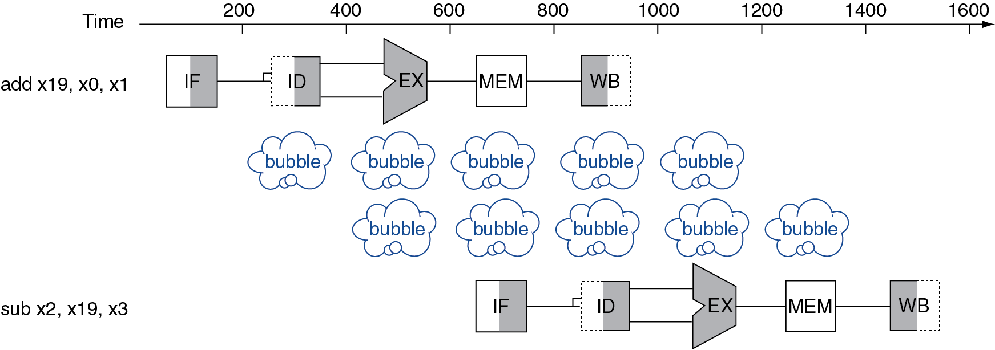
Data Hazards
An instruction depends on completion of data access by a previous instruction
add x19, x0, x1 sub x2, x19, x3

Slide 89
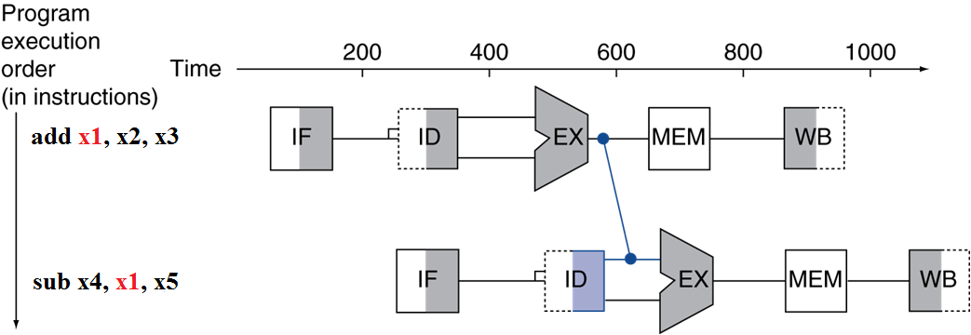
Forwarding (aka Bypassing)
Use result when it is computed
Don’t wait for it to be stored in a register
Requires extra connections in the datapath

Slide 90
Data Hazards: Forwarding vs. Stalling ALU Instructions
Consider this sequence:
sub x2, x1,x3 and x12,x2,x5 or x13,x6,x2 add x14,x2,x2 sd x15,100(x2)
We can resolve hazards with forwarding
How do we detect when to forward?

Slide 91
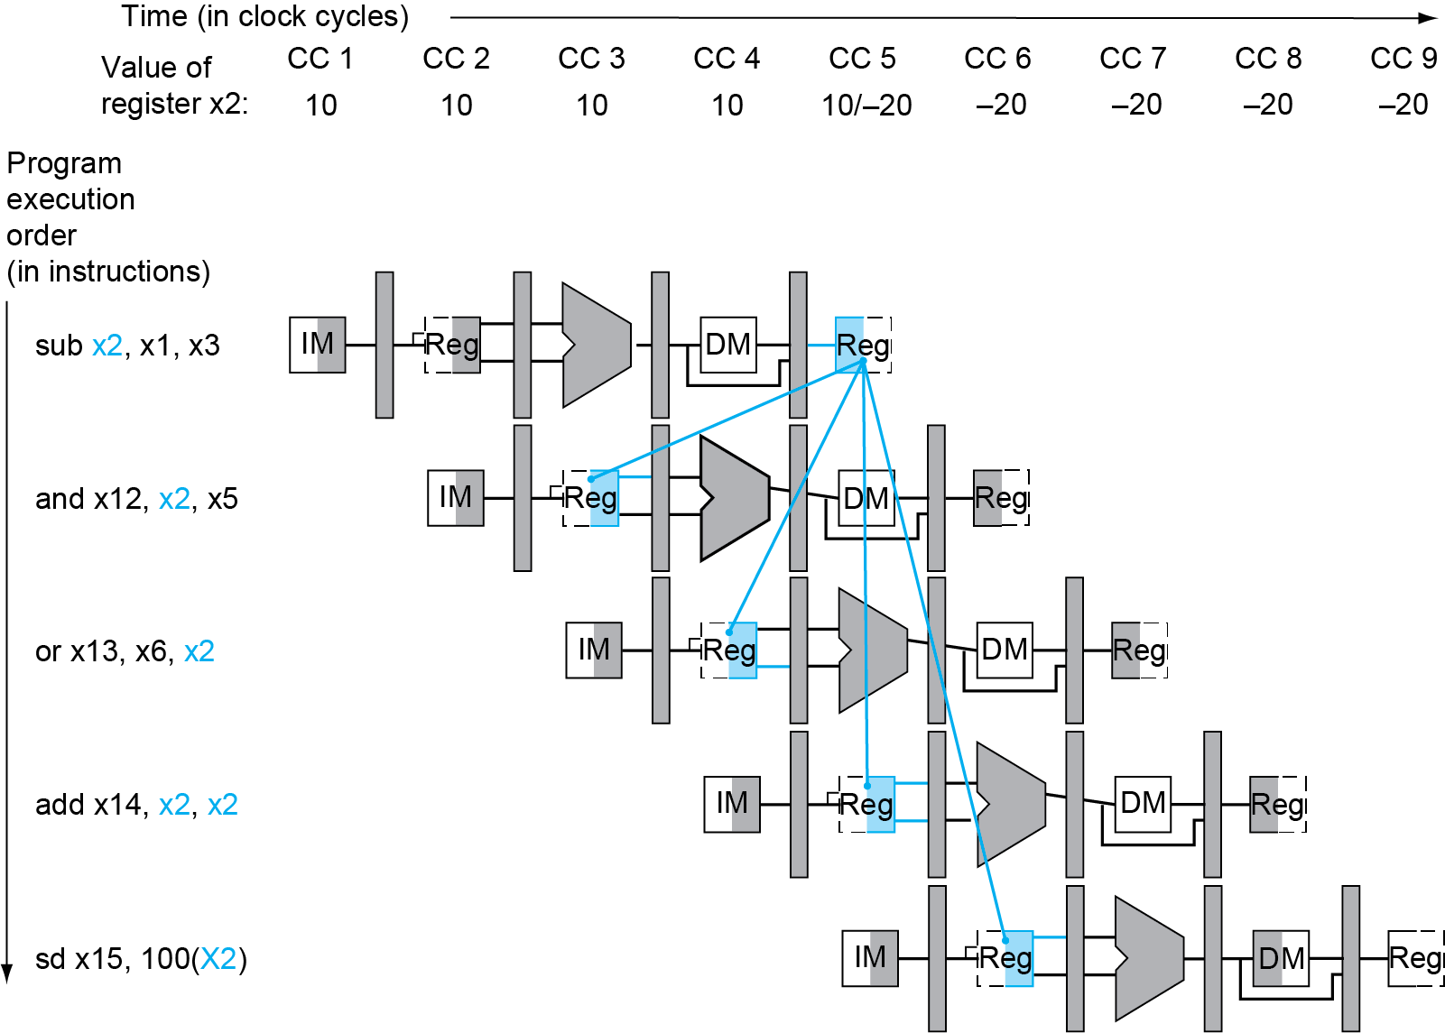
Dependencies & Forwarding

Slide 92
Hardware Change for Forwarding
NextPC
ID/EX
EX/MEM
MEM/WR
Registers
mux
When to use the red. Blue
purple forwording path ?
ALU
Data
Memory
mux
mux
Immediate
Source → sink
EX/Mem.ALUoutput → ALU input
MEM/WB.ALUoutput → ALU input
MEM/WB.LMD → ALU input

Slide 93
When to use the forwarding path ?
EX/Mem.ALUoutput → ALU input
The previous instruction in EX/MEM is ALU
The instruction in ID/EX has Rs1 or Rs2 source register
EX/MEM.Rd == ID/EX.Rs1 or EX/MEM.Rd ==ID/EX.Rs2
MEM/WB.ALUoutput → ALU input
The previous instruction in MEM/WB is ALU
The instruction in ID/EX has Rs1 or Rs2 source register
MEM/WB.Rd == ID/EX.Rs1 or MEM/WB.Rd == IF/ID.Rs2
MEM/WB.LMD → ALU input
The previous instruction in MEM/WB is Load
The instruction in ID/EX has Rs1 or Rs2 source register
MEM/WB.Rd == ID/EX.Rs1 or MEM/WB.Rd == ID/EX.Rs2

Slide 94
Detecting the Need to Forward
Pass register numbers along pipeline
e.g., ID/EX.RegisterRs1 = register number for Rs1 sitting in ID/EX pipeline register
ALU operand register numbers in EX stage are given by
ID/EX.RegisterRs1, ID/EX.RegisterRs2
Data hazards when
1a. EX/MEM.RegisterRd = ID/EX.RegisterRs1
1b. EX/MEM.RegisterRd = ID/EX.RegisterRs2
2a. MEM/WB.RegisterRd = ID/EX.RegisterRs1
2b. MEM/WB.RegisterRd = ID/EX.RegisterRs2
Fwd from EX/MEM pipeline reg
Fwd from MEM/WB pipeline reg

Slide 95
Detecting the Need to Forward
But only if forwarding instruction will write to a register!
EX/MEM.RegWrite, MEM/WB.RegWrite
And only if Rd for that instruction is not x0
EX/MEM.RegisterRd ≠ 0, MEM/WB.RegisterRd ≠ 0
Notes:
（1）必须是写的冲突， 否则的话，还有情形是？ branch
（2）？？ 默认无法读写的

Slide 96
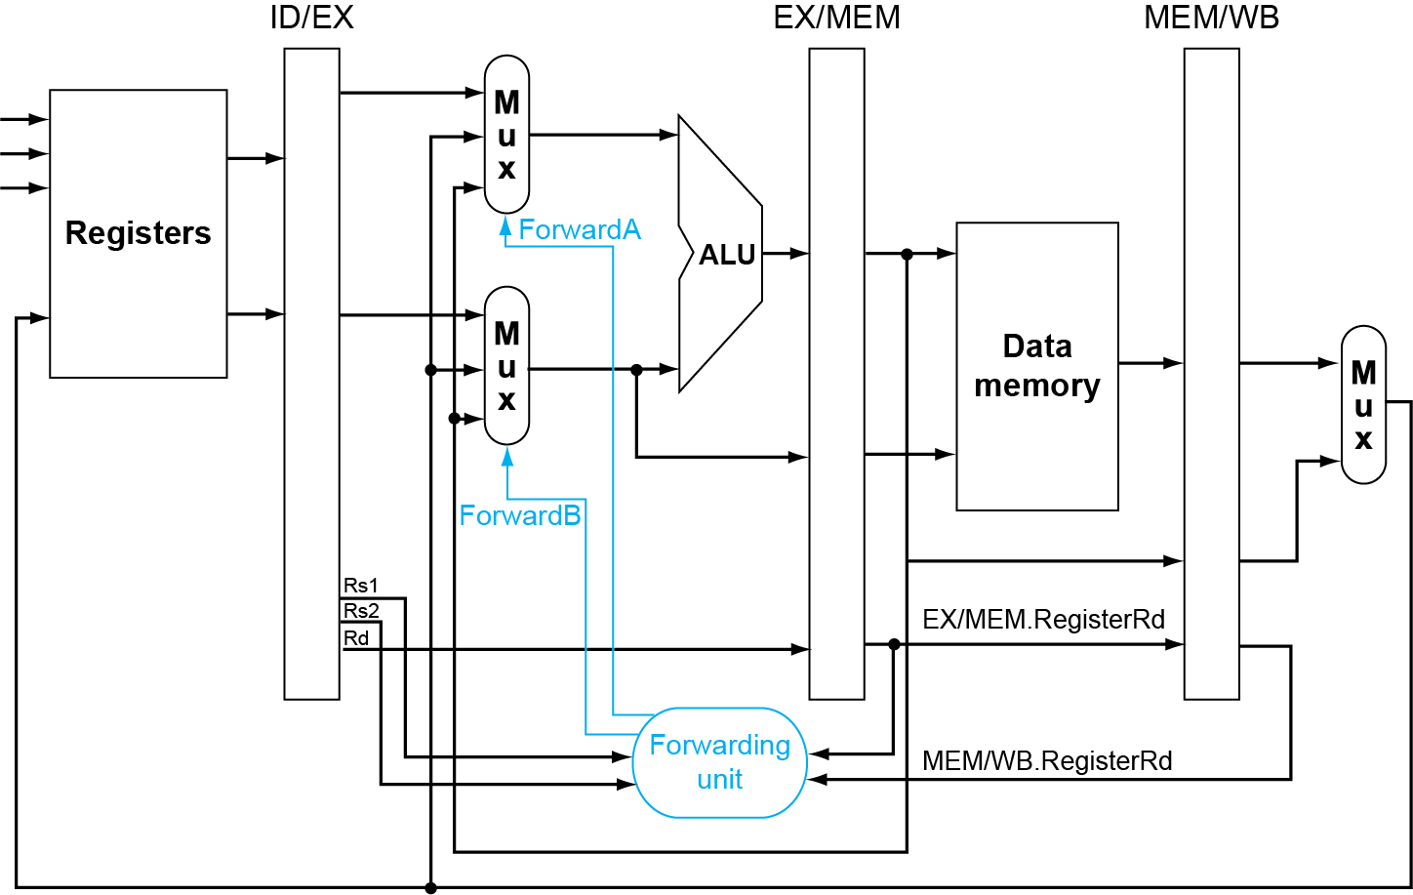
Forwarding Paths

Slide 97
Forwarding Conditions
EX hazard
if (EX/MEM.RegWrite and (EX/MEM.RegisterRd ≠ 0) and (EX/MEM.RegisterRd = ID/EX.RegisterRs1)) ForwardA = 10
if (EX/MEM.RegWrite and (EX/MEM.RegisterRd ≠ 0) and (EX/MEM.RegisterRd = ID/EX.RegisterRs2)) ForwardB = 10
MEM hazard
if (MEM/WB.RegWrite and (MEM/WB.RegisterRd ≠ 0) and (MEM/WB.RegisterRd = ID/EX.RegisterRs1)) ForwardA = 01
if (MEM/WB.RegWrite and (MEM/WB.RegisterRd ≠ 0) and (MEM/WB.RegisterRd = ID/EX.RegisterRs2)) ForwardB = 01

Slide 98
Double Data Hazard
Consider the sequence:
add x1,x1,x2 add x1,x1,x3 add x1,x1,x4
Both hazards occur
Want to use the most recent
Revise MEM hazard condition
Only fwd if EX hazard condition isn’t true

Slide 99
Revised Forwarding Condition
MEM hazard
if (MEM/WB.RegWrite and (MEM/WB.RegisterRd ≠ 0) and not (EX/MEM.RegWrite and (EX/MEM.RegisterRd ≠ 0) and (EX/MEM.RegisterRd = ID/EX.RegisterRs1)) and (MEM/WB.RegisterRd = ID/EX.RegisterRs1)) ForwardA = 01
if (MEM/WB.RegWrite and (MEM/WB.RegisterRd ≠ 0) and not (EX/MEM.RegWrite and (EX/MEM.RegisterRd ≠ 0) and (EX/MEM.RegisterRd = ID/EX.RegisterRs2)) and (MEM/WB.RegisterRd = ID/EX.RegisterRs2)) ForwardB = 01

Slide 100
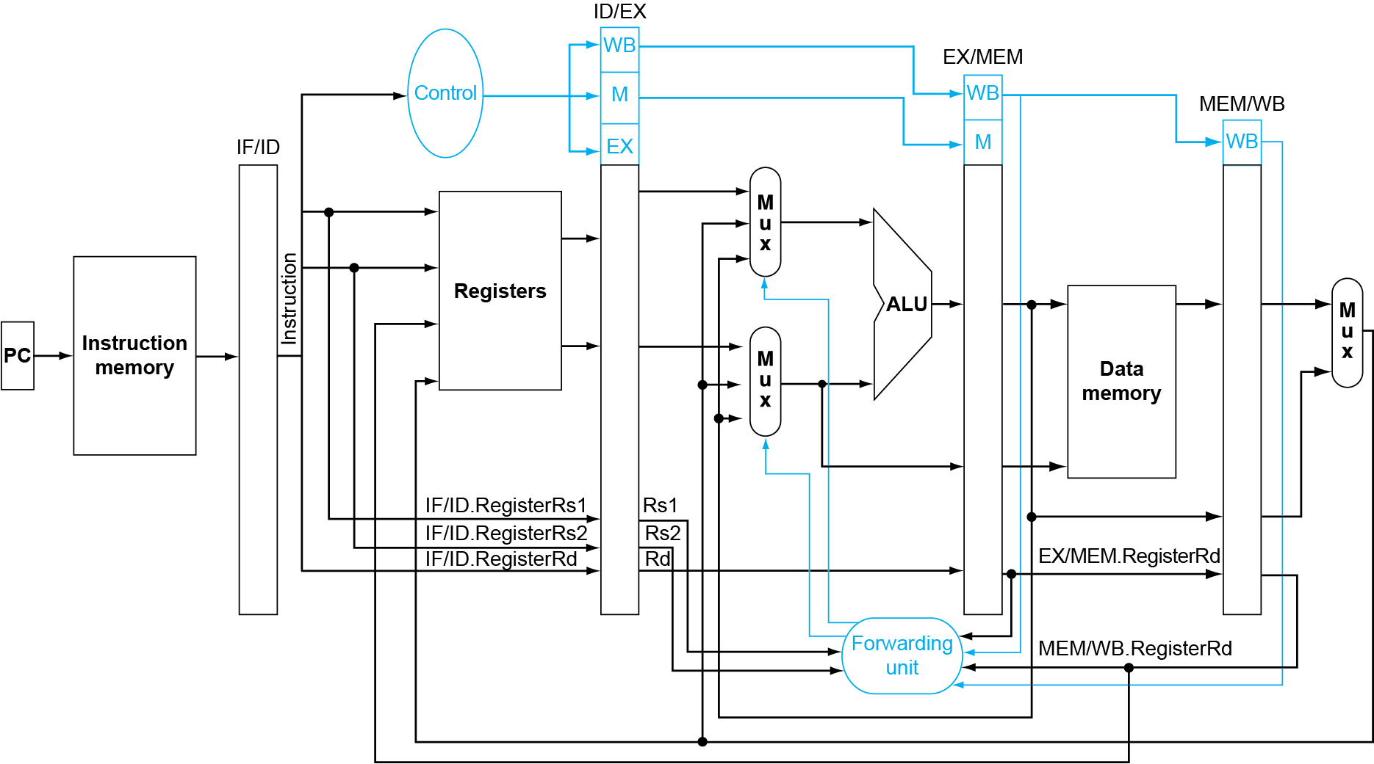
Datapath with Forwarding

Slide 101
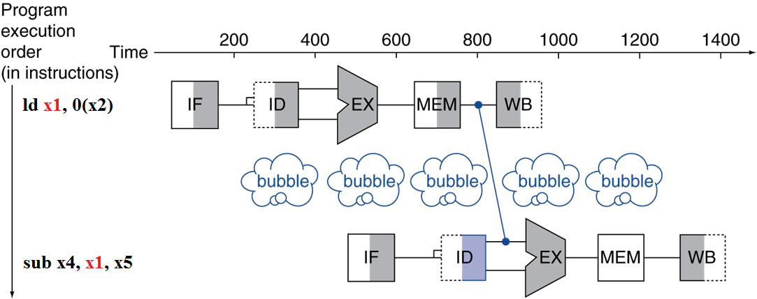
Load-Use Data Hazard
Can’t always avoid stalls by forwarding
If value not computed when needed
Can’t forward backward in time!

Slide 102
Code Scheduling to Avoid Stalls
Reorder code to avoid use of load result in the next instruction
C code for A = B + E; C = B + F;
ld x1, 0(x31)
ld x2, 8(x31)
add x3, x1, x2
sd x3, 24(x31)
ld x4, 16(x31)
add x5, x1, x4
sd x5, 32(x31)
ld x1, 0(x31)
ld x2, 8(x31)
ld x4, 16(x31)
add x3, x1, x2
sd x3, 24(x31)
add x5, x1, x4
sd x5, 32(x31)
stall
stall
9 cycles
7 cycles
Notes:
B的值放到 x1中
E的值放到 x2中
x3中放 A
F的值放到 x4中
x5中放 A
主要是前面的load-use data hazard

Slide 103
Detect when should use Load Stall
situation | Example code sequence | Action
No dependence | LD R1, 45(R2) DADD R5,R6,R7 DSUB R8,R6,R7 OR R9,R6,R7 | No hazard possible because of no dependence
Dependence requiring stall | LD R1, 45(R2) DADD R5,R1,R7 DSUB R8,R6,R7 OR R9,R6,R7 | Comparators detect the use of R1 in the DADD and stall the DADD (and DSUB and OR ) before the DADD begins EX
Dependence overcome by forwarding | LD R1, 45(R2) DADD R5,R6,R7 DSUB R8,R1,R7 OR R9,R6,R7 | Comparators detect the use of R1 in DSUB and forward result of load to ALU in time for DSUB to begin EX
Dependence with accesses in order | LD R1, 45(R2) DADD R5,R6,R7 DSUB R8,R6,R7 OR R9,R1,R7 | No action required because read of R1 by OR occurs in the second half of the ID phase, while the write of the loaded data occurred in the first half.

Slide 104
Load-Use Hazard Detection
Check when using instruction is decoded in ID stage
ALU operand register numbers in ID stage are given by
IF/ID.RegisterRs1, IF/ID.RegisterRs2
Load-use hazard when
ID/EX.MemRead and ((ID/EX.RegisterRd = IF/ID.RegisterRs1) or (ID/EX.RegisterRd = IF/ID.RegisterRs2))
If detected, stall and insert bubble

Slide 105
How to Stall the Pipeline
Force control values in ID/EX register to 0
EX, MEM and WB do nop (no-operation)
Prevent update of PC and IF/ID register
Using instruction is decoded again
Following instruction is fetched again
1-cycle stall allows MEM to read data for ld
Can subsequently forward to EX stage

Slide 106
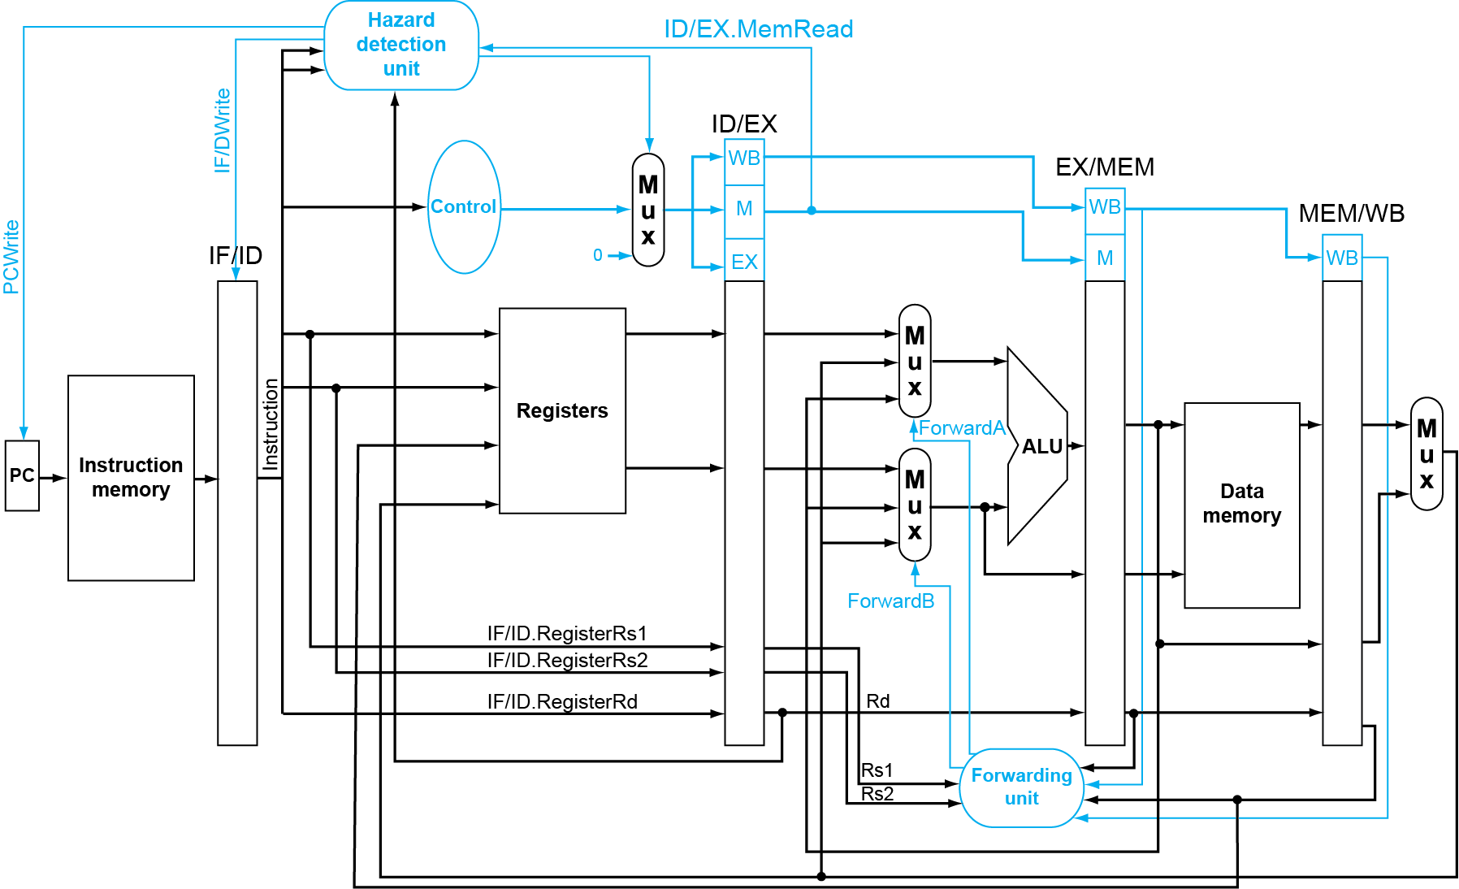
Datapath with Hazard Detection

Slide 107
Example of Forwarding and Load Stall
Why forwarding?
ADD R4, R5, R2
LW R15, 0(R4)
SW R15, 4(R2)
Why load delay?
ADD R4, R5, R2
LW R15, 0(R4)
SW R15, 4(R2)

Slide 108
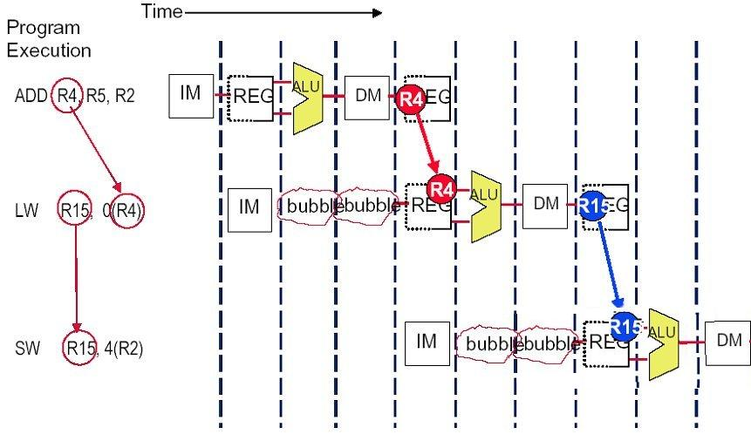
Solution (without forwarding)

Slide 109
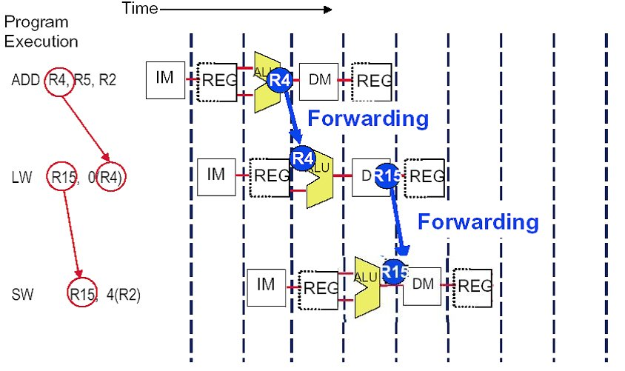
Solution (with forwarding)
EX/MEM.ALUoutput → ALU input port
MEM/WB.LDMR→ DM data write port

Slide 110
performance influence of load stall
Example
Assume 30% of the instructions are loads.
Half the time, instruction following a load instruction depends on the result of the load.
If hazard causes a single cycle delay, how much faster is the ideal pipeline ?
Answer
CPI = 1+30%×50% ×1=1.15
The performance decrease about 15% due to load stall.

Slide 111
Fraction of load that cause a stall

Slide 112
Summary of Data Hazards
Instruction depends on result of prior computation which is not ready yet
Not computed
Not stored
Solutions
Double bump
Forwarding
Compiler scheduling
Stall

Slide 113
Hazards
Situations that prevent starting the next instruction in the next cycle
Structure hazards
A required resource is busy
Data hazard
Need to wait for previous instruction to complete its data read/write
Control hazard
Deciding on control action depends on previous instruction
Notes:
Hazard 冒险，竞争

Slide 114
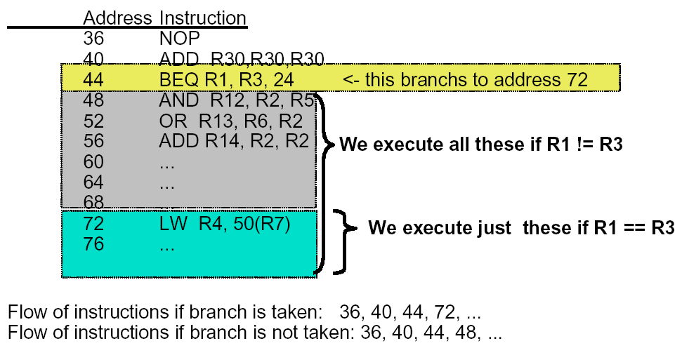
Example: Branches
R3, 24

Slide 115
Recall: Basic Pipelined Datapath

Slide 116
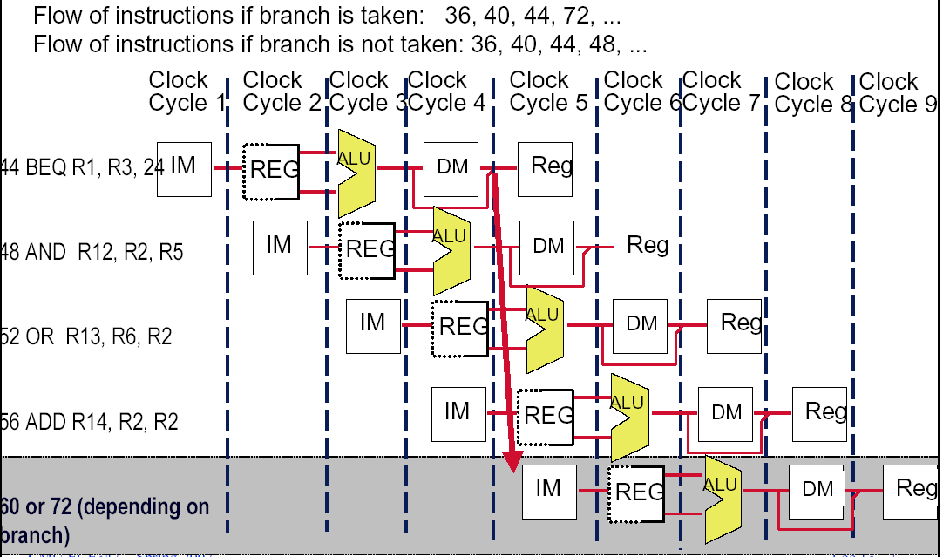
Control hazard

Slide 117
Dealing with the control hazard
Four simple solutions
Stall
Prediction
Predict-untaken: treat every branch as not taken
Predict-taken: treat every branch as taken
Note:
Fixed hardware
Compile time scheme using knowledge of hardware scheme and of branch behavior

Slide 118
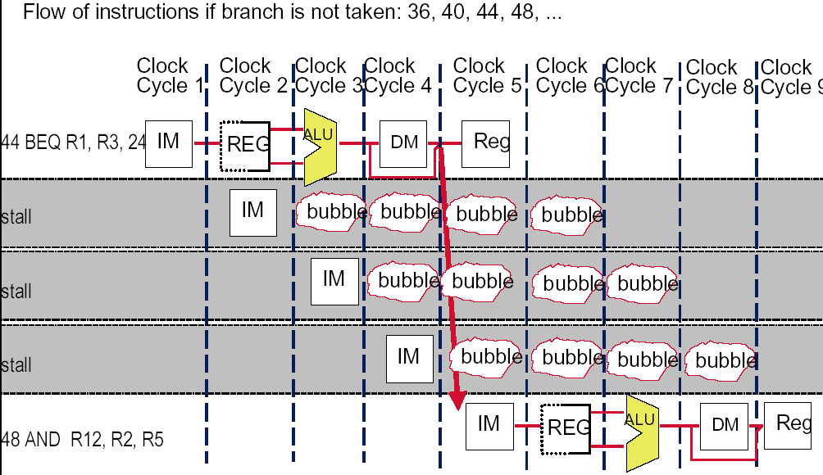
Recall: solve the hazard by inserting stalls
48 or 72
24

Slide 119
Flushing the pipeline
Simplest hardware:
Holding or deleting any instruction after branch until the branch destination is know.
Penalty is fixed.
Can not be reduced by software.

Slide 120
Stalls greatly hurt the performance
Problem:
With a 30% branch frequency and an ideal CPI of 1, how much the performace is by inserting stalls ?
Answer:
CPI = 1+30%×３＝1.9
this simple solution achieves only about half of the ideal performance.

Slide 121
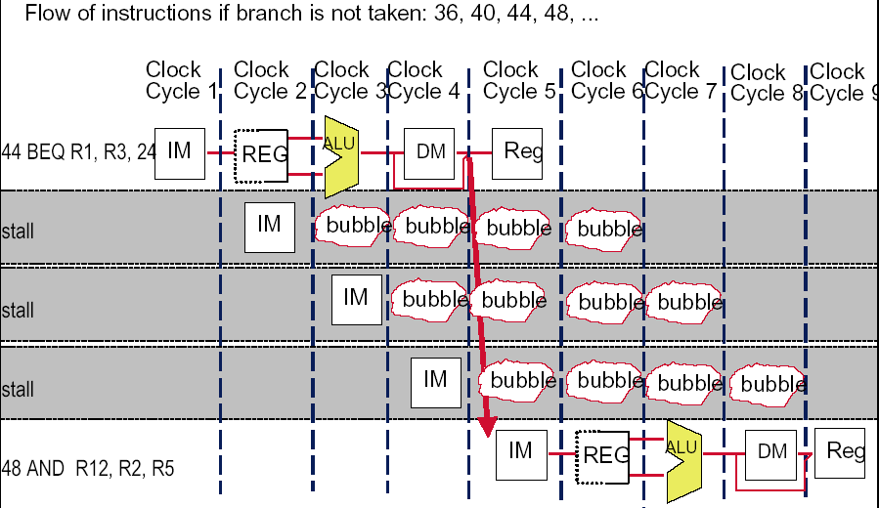
Always Stall Hurts the Not- taken case
24

Slide 122
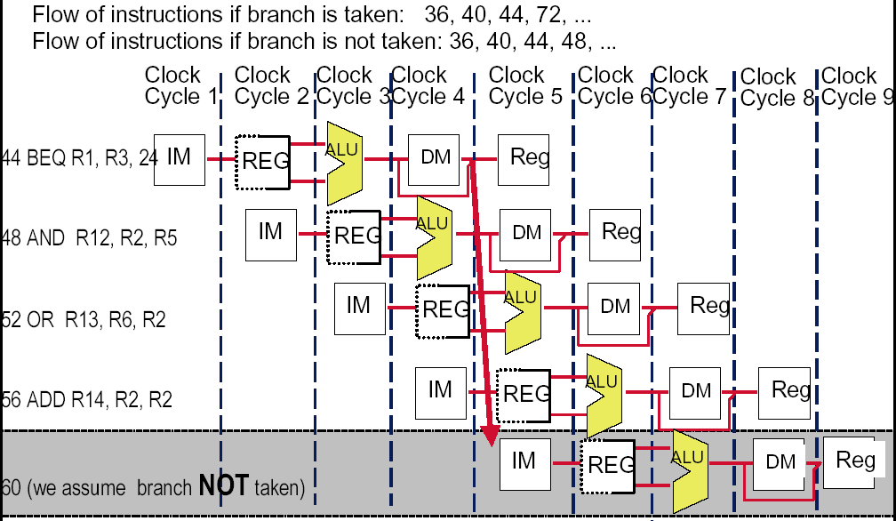
How about assume Branch Not Taken

Slide 123
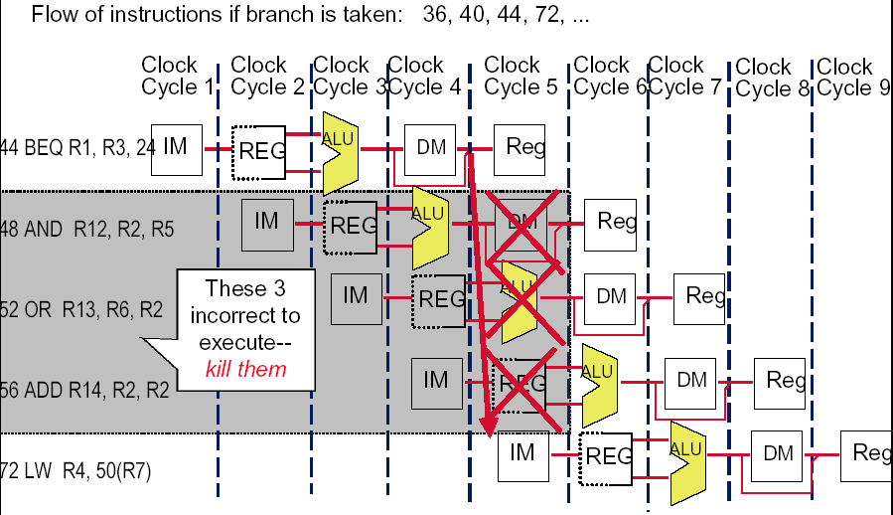
How to do with the branch taken ?
24

Slide 124
Predict –not-taken
Hardware:
Treat every branch as not taken (or as the formal instruction)
When branch is not taken, the fetched instruction just continues to flow on. No stall at all.
If the branch is taken, then restart the fetch at the branch target, which cause 3 stall.(should turn the fetched instruction into a no-op)
Perf = 1+ br% * take%* 3
Compiler:
Can improve the performance by coding the most frequent case in the untaken path.

Slide 125
Which code segment is better ?
If cond=(malloc(..))
Then statements_taken
Else statements_not_taken
If not cond
Then statements_not_taken
Else statements_taken

Slide 126
Alternative is assuming the branch always taken
Most branches(60%) are taken, so we should make the taken branch more faster. Why not try assuming the branch always taken?

Slide 127
Predict –taken
Hardware
Treat every branch as taken (evidence: more than 60% braches are taken)
As soon as the branch target address is computed, assume the branch to be taken and begin fetching and executing at the target.
Only useful when the target is known before the branch outcome.
No advantage at all for RISC-V 5-stage pipeline.
Compiler
Can improve the performance by coding the most frequent case in the taken path.

Slide 128
Pipeline status for predict-taken
Branch is taken: 1 stall perf=1+Br%*( taken%*1+untaken%*3)
44 BEQ R1, 24 | IF | ID | EX | MEM | WB
48 AND R12, R2, R5 |  | IF | idle | idle | idle | idle
72 LW R4, 50(R7) |  |  | IF | ID | EX | MEM | WB
76 |  |  |  | IF | ID | EX | MEM
80 |  |  |  |  | IF | ID | EX
Branch is not taken: 3 stall
44 BEQ R1, 24 | IF | ID | EX | MEM | WB
48 AND R12, R2, R5 |  | IF | idle | idle | idle | idle
72 LW R4, 50(R7) |  |  | IF | ID | idle | idle | idle
76 |  |  |  | IF | idle | idle | idle
48 AND R12, R2, R5 |  |  |  |  | IF | ID | EX

Slide 129
Control Hazards
Branch determines flow of control
Fetching next instruction depends on branch outcome
Pipeline can’t always fetch correct instruction
Still working on ID stage of branch
In RISC-V pipeline
Need to compare registers and compute target early in the pipeline
Add hardware to do it in ID stage

Slide 130
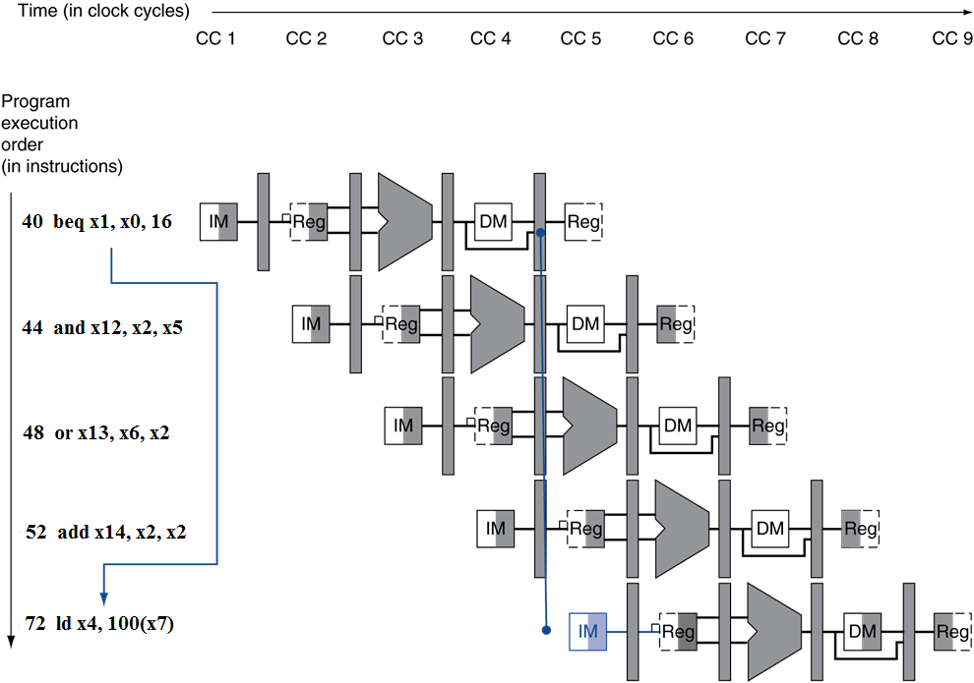
Control Hazards – Branch Instruction
If branch outcome determined in MEM
Flush these instructions
(Set control values to 0)
PC

Slide 131
Move the Branch Computation Forward

Slide 132
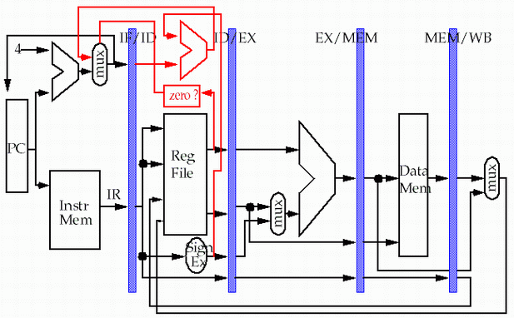
Move the Branch Computation more Forward
store
load

Slide 133

Result: New & Improved MIPS Datapath
Need just 1 extra cycle after the BEQ branch to know right address
48 or 72

Slide 134

Flushing : need only to insert 1 stall to resolve control hazard
48 or 72
40 ADD R30,R30,R30 | IF | ID | EX | MEM | WB
44 BEQ R1, 24 |  | IF | ID | EX | MEM | WB
48 AND R12, R2, R5 |  |  | IF | idle | idle | idle | idle
48 or 72 |  |  |  | IF | ID | EX | MEM

Slide 135
Why “waste” the fetched instruction ?
48 or 72
We have fetched the instruction 48, why we fetch the second time if the branch not taken at last ?

Slide 136

RISC-V with Predict Not Taken
Prediction correct
Prediction incorrect

Slide 137
Reducing Branch Delay
Move hardware to determine outcome to ID stage
Target address adder
Register comparator
Example: branch taken
36: sub x10, x4, x8 40: beq x1, x3, 16 //PC-relative branch to 40+16*2=72 44: and x12, x2, x5 48: or x13, x2, x6 52: add x14, x4, x2 56: sub x15, x6, x7 ... 72: ld x4, 50(x7)

Slide 138

Example: Branch Taken

Slide 139

Example: Branch Taken

Slide 140
Data Hazards for Branches
If a comparison register is a destination of 2nd or 3rd preceding ALU instruction
add x1, x2, x3
IF
ID
EX
MEM
WB
add x4, x5, x6
IF
ID
EX
MEM
WB
…
IF
ID
EX
MEM
WB
beq x1, x4, target
IF
ID
EX
MEM
WB
Can resolve using forwarding

Slide 141
Data Hazards for Branches
If a comparison register is a destination of preceding ALU instruction or 2nd preceding load instruction
Need 1 stall cycle
ld x1, addr
IF
ID
EX
MEM
WB
add x4, x5, x6
IF
ID
EX
MEM
WB
beq stalled
IF
ID
beq x1, x4, target
ID
EX
MEM
WB

Slide 142
Data Hazards for Branches
If a comparison register is a destination of immediately preceding load instruction
Need 2 stall cycles
ld x1, addr
IF
ID
EX
MEM
WB
beq stalled
IF
ID
beq stalled
ID
beq x1, x0, target
ID
EX
MEM
WB

Slide 143
More-Realistic Branch Prediction
Static branch prediction
Based on typical branch behavior
Example: loop and if-statement branches
Predict backward branches taken
Predict forward branches not taken
Dynamic branch prediction
Hardware measures actual branch behavior
e.g., record recent history of each branch
Assume future behavior will continue the trend
When wrong, stall while re-fetching, and update history

Slide 144
Accuracy of prediction based on profile

Slide 145
Dynamic Branch Prediction
In deeper and superscalar pipelines, branch penalty is more significant
Use dynamic prediction
Branch prediction buffer (aka branch history table)
Indexed by recent branch instruction addresses
Stores outcome (taken/not taken)
To execute a branch
Check table, expect the same outcome
Start fetching from fall-through or target
If wrong, flush pipeline and flip prediction

Slide 146
1-bit predictor
Branch History Table: Lower bits of PC address index table of 1-bit values
Says whether or not branch taken last time
No address check (saves HW, but may not be right branch)
0：not taken
1：taken
0/1
Low bits of PC
预测行为
Complement when mispredict

Slide 147
1-Bit Predictor: Shortcoming
Inner loop branches mispredicted twice!
outer: … … inner: …
…
beq …, …, inner … beq …, …, outer
Mispredict as taken on last iteration of inner loop
Then mispredict as not taken on first iteration of inner loop next time around

Slide 148

2-Bit Predictor
Only change prediction on two successive mispredictions

Slide 149
An alternative 2-bit predictor
It can be implemented using a 2-bit counter
T
NT
Predict Taken
Surely
Predict Taken
T
T
NT
NT
Predict Not
Taken
Predict Not
Taken surely
T
NT

Slide 150
Accuracy of the 2-bit predictor
4096 entries, 2-bit predictor
SPEC89
Accuracy : 99%~82%
Misprediction: 1%~18%

Slide 151
Calculating the Branch Target
Even with predictor, still need to calculate the target address
1-cycle penalty for a taken branch
Branch target buffer
Cache of target addresses
Indexed by PC when instruction fetched
If hit and instruction is branch predicted taken, can fetch target immediately

Slide 152
Summary for control hazard
branch condition and the branch PC are not available in time to fetch an instruction on the next clock
OK, we did these, calculate the destination address and condition asap, Flushing the pipeline, predict-not-taken, predict-taken, delayed branc
Control hazards can cause a greater performance loss than do data hazards.
In general, the deeper the pipeline, the worse the branch penalty in clock cycles.
A higher CPI processor can afford to have more expensive branches.
The efficiency of the three schemes greatly depends on the branch prediction.

Slide 153
4.9 Exceptions
“Unexpected” events requiring change in flow of control
Different ISAs use the terms differently
Exception
Arises within the CPU
e.g., undefined opcode, overflow, syscall, …
Interrupt
From an external I/O controller
Dealing with them without sacrificing performance is hard

Slide 154
Handling Exceptions
Save PC of offending (or interrupted) instruction
In RISC-V: Supervisor Exception Program Counter (SEPC)
Save indication of the problem
In RISC-V : Cause register (SCAUSE)
We’ll assume 1-bit
0 for undefined instruction, 1 for system error
Jump to handler at 0000 0000 1C09 0000

Slide 155
An Alternate Mechanism
Vectored Interrupts
Handler address determined by the cause
Example:
Undefined instruction: 00 0100 0000
System error: 01 1000 0000
…: 11 1000 0000
Jump to real handler by the cause of the exception

Slide 156
Handler Actions
Read cause, and transfer to relevant handler
Determine action required
If restartable
Take corrective action
use SEPC to return to program
Otherwise
Terminate program
Report error using SEPC, cause, …

Slide 157
Exceptions in a Pipeline
Another form of control hazard
Consider overflow on add in EX stage
add x1, x2, x1
Prevent x1 from being clobbered
Complete previous instructions
Flush add and subsequent instructions
Set Cause and SEPC register values
Transfer control to handler
Similar to mispredicted branch
Use much of the same hardware
Notes:
Clobber 重复打击，重复出错

Slide 158

Pipeline with Exceptions

Slide 159
Exception Properties
Restartable exceptions
Pipeline can flush the instruction
Handler executes, then returns to the instruction
Refetched and executed from scratch
PC saved in SEPC register
SCAUSE register records the highest priority exception

Slide 160
Multiple Exceptions
Pipelining overlaps multiple instructions
Could have multiple exceptions at once
Simple approach: deal with exception from earliest instruction
Flush subsequent instructions
“Precise” exceptions
In complex pipelines
Multiple instructions issued per cycle
Out-of-order completion
Maintaining precise exceptions is difficult!
Notes:
Precise exceptions 课本321页

Slide 161
Imprecise Exceptions
Just stop pipeline and save state
Including exception cause(s)
Let the handler work out
Which instruction(s) had exceptions
Which to complete or flush
May require “manual” completion
Simplifies hardware, but more complex handler software
Not feasible for complex multiple-issue out-of-order pipelines

Slide 162
Instruction-Level Parallelism (ILP)
Pipelining: executing multiple instructions in parallel
To increase ILP
Deeper pipeline
Less work per stage ⇒ shorter clock cycle
Multiple issue
Replicate pipeline stages ⇒ multiple pipelines
Start multiple instructions per clock cycle
CPI < 1, so use Instructions Per Cycle (IPC)
E.g., 4GHz 4-way multiple-issue
16 BIPS, peak CPI = 0.25, peak IPC = 4
But dependencies reduce this in practice

Slide 163
Multiple Issue
Static multiple issue
Compiler groups instructions to be issued together
Packages them into “issue slots”
Compiler detects and avoids hazards
Dynamic multiple issue
CPU examines instruction stream and chooses instructions to issue each cycle
Compiler can help by reordering instructions
CPU resolves hazards using advanced techniques at runtime

Slide 164
Speculation
“Guess” what to do with an instruction
Start operation as soon as possible
Check whether guess was right
If so, complete the operation
If not, roll-back and do the right thing
Common to static and dynamic multiple issue
Examples
Speculate on branch outcome
Roll back if path taken is different
Speculate on load
Roll back if location is updated
Notes:
Speculation 是和乱序执行 直接相关的
静态时候也可以做 speculation

Slide 165
Compiler/Hardware Speculation
Compiler can reorder instructions
e.g., move load before branch
Can include “fix-up” instructions to recover from incorrect guess
Hardware can look ahead for instructions to execute
Buffer results until it determines they are actually needed
Flush buffers on incorrect speculation

Slide 166
Speculation and Exceptions
What if exception occurs on a speculatively executed instruction?
e.g., speculative load before null-pointer check
Static speculation
Can add ISA support for deferring exceptions
Dynamic speculation
Can buffer exceptions until instruction completion (which may not occur)

Slide 167
Static Multiple Issue
Compiler groups instructions into “issue packets”
Group of instructions that can be issued on a single cycle
Determined by pipeline resources required
Think of an issue packet as a very long instruction
Specifies multiple concurrent operations
⇒ Very Long Instruction Word (VLIW)

Slide 168
Scheduling Static Multiple Issue
Compiler must remove some/all hazards
Reorder instructions into issue packets
No dependencies with a packet
Possibly some dependencies between packets
Varies between ISAs; compiler must know!
Pad with nop if necessary

Slide 169
RISC-V with Static Dual Issue
Two-issue packets
One ALU/branch instruction
One load/store instruction
64-bit aligned
ALU/branch, then load/store
Pad an unused instruction with nop
Address | Instruction type | Pipeline Stages
n | ALU/branch | IF | ID | EX | MEM | WB
n + 4 | Load/store | IF | ID | EX | MEM | WB
n + 8 | ALU/branch |  | IF | ID | EX | MEM | WB
n + 12 | Load/store |  | IF | ID | EX | MEM | WB
n + 16 | ALU/branch |  |  | IF | ID | EX | MEM | WB
n + 20 | Load/store |  |  | IF | ID | EX | MEM | WB

Slide 170

RISC-V with Static Dual Issue

Slide 171
Hazards in the Dual-Issue RISC-V
More instructions executing in parallel
EX data hazard
Forwarding avoided stalls with single-issue
Now can’t use ALU result in load/store in same packet
add x5, x0, x1 load x2, 0(x5)
Split into two packets, effectively a stall
Load-use hazard
Still one cycle use latency, but now two instructions
More aggressive scheduling required

Slide 172
Scheduling Example
Schedule this for dual-issue RISC-V
Loop: ld x31, 0(x20) // x31=array element add x31, x31, x21 // add scalar in x21 sd x31, 8(x20) // store result addi x20, x20,–8 // decrement pointer blt x22, x20, Loop // branch if x20 > x22
 | ALU/branch | Load/store | cycle
Loop: | nop | ld x31, 0(x20) | 1
 | addi x20, x20, –8 | nop | 2
 | Add x31, x31, x21 | nop | 3
 | blt x22, x20, Loop | sd x31, 8(x20) | 4
IPC = 5/4 = 1.25 (c.f. peak IPC = 2)

Slide 173
Loop Unrolling
Replicate loop body to expose more parallelism
Reduces loop-control overhead
Use different registers per replication
Called “register renaming”
Avoid loop-carried “anti-dependencies”
Store followed by a load of the same register
Aka “name dependence”
Reuse of a register name
Notes:
Loop unfolding
寄存器重命名技术在乱序执行流水线中有两个作用。一是消除指令之间的寄存器读后写相关（WAR），和写后写相关（WAW）；二是当指令执行发生例外或转移指令猜测错误而取消后面的指令时可以保证现场的精确。寄存器重命名的思路很简单：就是当一条指令写一个结果寄存器时不直接写到这个结果寄存器，而是先写到一个中间寄存器过渡一下，当这条指令提交的时候再写到结果寄存器中。
Anti Dependence[edit]
An anti dependence occurs when a location in memory is read before that same location is written to.^{[1][2][3]} This introduces write-after-read (WAR) hazards because the instruction that writes the data into a memory location has to wait until that memory location has been read by the previous instruction or else the reading instruction would read the wrong value.^{[2]} An example of an anti dependence is:

Slide 174
Loop Unrolling Example
 | ALU/branch | Load/store | cycle
Loop: | addi x20, x20,–32 | ld x28, 0(x20) | 1
 | nop | ld x29, 24(x20) | 2
 | add x28, x28, x21 | ld x30, 16(x20) | 3
 | add x29, x29, x21 | ld x31, 8(x20) | 4
 | add x30, x30, x21 | sd x28, 32(x20) | 5
 | add x31, x31, x21 | sd x29, 24(x20) | 6
 | nop | sd x30, 16(x20) | 7
 | blt x22, x20, Loop | sd x31, 8(x20) | 8
IPC = 14/8 = 1.75
Closer to 2, but at cost of registers and code size

Slide 175
Dynamic Multiple Issue
“Superscalar” processors
CPU decides whether to issue 0, 1, 2, … each cycle
Avoiding structural and data hazards
Avoids the need for compiler scheduling
Though it may still help
Code semantics ensured by the CPU
Notes:
Superscalar 超标量处理器

Slide 176
Dynamic Pipeline Scheduling
Allow the CPU to execute instructions out of order to avoid stalls
But commit result to registers in order
Example
ld x31, 0(x21) add x1, x31, x2 sub x23, x23, x3 andi x5, x23, 20
Can start sub while add is waiting for ld

Slide 177

Dynamically Scheduled CPU
Preserves dependencies
Hold pending operands
Results also sent to any waiting reservation stations
Reorders buffer for register writes
Can supply operands for issued instructions

Slide 178
Register Renaming
Reservation stations and reorder buffer effectively provide register renaming
On instruction issue to reservation station
If operand is available in register file or reorder buffer
Copied to reservation station
No longer required in the register; can be overwritten
If operand is not yet available
It will be provided to the reservation station by a function unit
Register update may not be required

Slide 179
Speculation
Predict branch and continue issuing
Don’t commit until branch outcome determined
Load speculation
Avoid load and cache miss delay
Predict the effective address
Predict loaded value
Load before completing outstanding stores
Bypass stored values to load unit
Don’t commit load until speculation cleared

Slide 180
Why Do Dynamic Scheduling?
Why not just let the compiler schedule code?
Not all stalls are predicable
e.g., cache misses
Can’t always schedule around branches
Branch outcome is dynamically determined
Different implementations of an ISA have different latencies and hazards

Slide 181
Does Multiple Issue Work?
The BIG Picture
Yes, but not as much as we’d like
Programs have real dependencies that limit ILP
Some dependencies are hard to eliminate
e.g., pointer aliasing
Some parallelism is hard to expose
Limited window size during instruction issue
Memory delays and limited bandwidth
Hard to keep pipelines full
Speculation can help if done well

Slide 182
Power Efficiency
Complexity of dynamic scheduling and speculations requires power
Multiple simpler cores may be better
Microprocessor | Year | Clock Rate | Pipeline Stages | Issue width | Out-of-order/ Speculation | Cores | Power
i486 | 1989 | 25MHz | 5 | 1 | No | 1 | 5W
Pentium | 1993 | 66MHz | 5 | 2 | No | 1 | 10W
Pentium Pro | 1997 | 200MHz | 10 | 3 | Yes | 1 | 29W
P4 Willamette | 2001 | 2000MHz | 22 | 3 | Yes | 1 | 75W
P4 Prescott | 2004 | 3600MHz | 31 | 3 | Yes | 1 | 103W
Core | 2006 | 2930MHz | 14 | 4 | Yes | 2 | 75W
UltraSparc III | 2003 | 1950MHz | 14 | 4 | No | 1 | 90W
UltraSparc T1 | 2005 | 1200MHz | 6 | 1 | No | 8 | 70W

Slide 183
ARM处理器体系结构
ARM内核工作模式：
用户模式（user）：正常程序执行模式；
快速中断模式（FIQ）：高优先级的中断产生会进入该种模式，用于高速通道传输；
外部中断模式（IRQ）：低优先级中断产生会进入该模式，用于普通的中断处理；
特权模式（Supervisor）：复位和软中断指令会进入该模式；
数据访问中止模式（Abort）：当存储异常时会进入该模式；
未定义指令中止模式（Undefined）：执行未定义指令会进入该模式；
系统模式（System）：用于运行特权级操作系统任务；
监控模式（Monitor）：可以在安全模式和非安全模式之间切换；

Slide 184
ARM处理器体系结构
ARM体系结构的指令集（Instruction Set）：
ARM指令集
Thumb指令集
Thumb-2指令集

Slide 185
ARM处理器体系结构
ARM的微体系结构（Micro-architecture）：
ARM处理器内核（Processor Core）
ARM处理器（Processor）
基于ARM架构处理器的片上系统（SoC）

Slide 186
ARM公司授权体系
ARM目前在全球拥有大约1000个授权合作商、320家伙伴，但是购买架构授权的厂家不超过20家，中国有华为、飞腾获得了架构授权。
按照所授权的架构和指令集（如ARMv8）自行编写代码、设计芯片。
架构/指令集授权
提供RTL代码，处理器的核数、缓存可以自己配置。自主设计主频、工艺、代工厂等。
处理器授权
处理器优化包/物理IP包授权（POP）
只能按照ARM设计好的处理器类型、在指定的代工厂进行生产。
Notes:
寄存器传输级（Register-Transfer Level, RTL）是通过硬件描述语言来描述实际电路的一种高层次模型。
处理器优化包 (Processor Optimization Pack, POP)。

Slide 187
ARM处理器体系结构
ARM流水线的执行顺序：
取指令（Fetch）：从存储器读取指令；
译码（Decode）：译码以鉴别它是属于哪一条指令；
执行（Execute）：将操作数进行组合以得到结果或存储器地址；
缓冲/数据（Buffer/data）：如果需要，则访问存储器以存储数据；
回写：（Write-back）：将结果写回到寄存器组中；

Slide 188

基于ARMv8的鲲鹏流水线技术
Branch预测和取指流水线解耦设计，取指流水线每拍最多可提供32Bytes指令供译码，分支预测流水线可以不受取指流水停顿影响，超前进行预测处理；
定浮点流水线分开设计，解除定浮点相互反压，每拍可为后端执行部件提供4条整型微指令及3条浮点微指令；
整型运算单元支持每拍4条ALU运算（含2条跳转）及1条乘除运算；
浮点及SIMD运算单元支持每拍2条ARM Neon 128bits 浮点及SIMD运算；
访存单元支持每拍2条读或写访存操作，读操作最快4拍完成，每拍访存带宽为2x128bits读及1x128bits写；

Slide 189
ARM处理器体系结构
ARM处理器的分类：
ARM经典处理器（Classic Processors）；
ARM Cortex应用处理器；
面向复杂操作系统和用户应用的Cortex-A（Applications，应用）系列
针对实时处理和控制应用的Cortex-R（Real-time，实时）系列
针对微控制器与低功耗应用优化的Cortex-M（Microcontroller）系列
ARM Cortex嵌入式处理器；
ARM专业处理器

Slide 190
ARM 处理器系列命名规则
命名格式：ARM {x} {y} {z} {T} {D} {M} {I}
x：处理器系列，是共享相同硬件特性的一组处理器，如：ARM7TDMI、ARM740T 都属于 ARM7 系列
y：存储管理 / 保护单元
z：Cache
T：Thumb，Thumb16 位译码器
D：Debug，JTAG 调试器
M：Multipler，快速乘法器
I：Embedded ICE Logic，嵌入式跟踪宏单元

Slide 191

ARM架构发展史 (1)

Slide 192

ARM架构发展史 (2)

Slide 193
ARM架构发展史 (3)
从ARM v7开始，CPU命名为Cortex，并划分为A、R、M三大系列，分别为不同的市场提供服务；
A (Application)系列：应用型处理器，面向具有复杂软件操作系统的面向用户的应用，为手机、平板、AP等终端设备提供全方位的解决方案；
R (Real-Time)系列：实时高性能处理器，为要求可靠性、高可用性、容错功能、可维护性和实时响应的嵌入式系统提供高性能计算解决方案；
M (Microcontroller)系列：高能效、易于使用的处理器，主要用于通用低端，工业，消费电子领域微控制器。

Slide 194


ARM架构发展史 (4)

Slide 195
ARM服务器处理器的优势
低功耗一直以来都是ARM架构芯片最大的优势；
ARM架构的芯片在成本、集成度方面也有较大的优势；
端、边、云全场景同构互联与协同；
更高的并发处理效率；
多元化的市场供应

Slide 196
4.15 Concluding Remarks
§4.15 Concluding emarks
ISA influences design of datapath and control
Datapath and control influence design of ISA
Pipelining improves instruction throughput using parallelism
More instructions completed per second
Latency for each instruction not reduced
Hazards: structural, data, control
Multiple issue and dynamic scheduling (ILP)
Dependencies limit achievable parallelism
Complexity leads to the power wall

Slide 197
END

